Slide 1

Discrete Math Chapter 4
Sets, Combination and Probability

Slide 2
Chapter 4 Overview
4-1 Introduction to Sets
4-2 Counting
4-3 Inclusive and Exclusive Principle
4-4 Permutations and Combinations
4-5 Binomial Theorem
4-6 Probability

Slide 3
Notes of Chapter 4
Chapter 4 is associated with chapter 1. You would not want to skip chapter 1 before learning this chapter.
In chapter 4, we will learn about permutations and combination; as a programmer, this might be one of the most important fundamental skills to have.
The idea of probability is used in machine learning (Naïve Bayes Theorem); computer scientist uses algorithms to determine the semantics and emotions of sentences.

Slide 4

4-1 Introduction to Sets

Slide 5
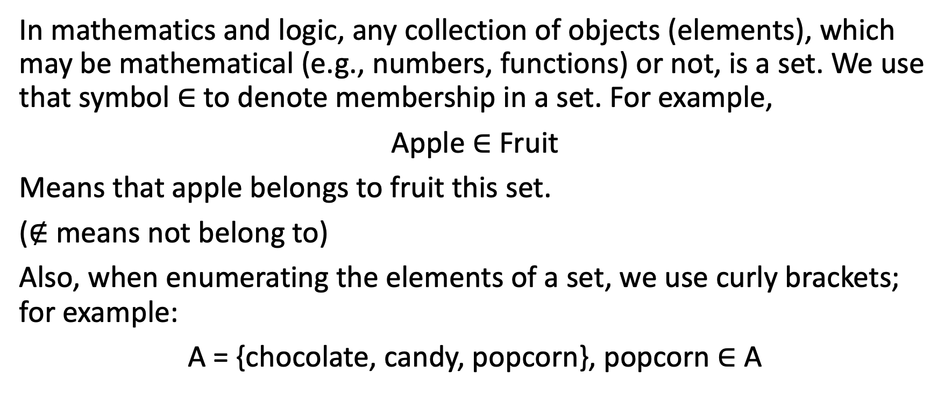
Sets and Notations
In mathematics and logic, any collection of objects (elements), which may be mathematical (e.g., numbers, functions) or not, is a set. We use that symbol $∈$ to denote membership in a set. For example,
Apple $∈$ Fruit
Means that apple belongs to fruit this set.
($∉$ means not belong to)
Also, when enumerating the elements of a set, we use curly brackets; for example:
A = {chocolate, candy, popcorn}, popcorn $∈$ A

Slide 6
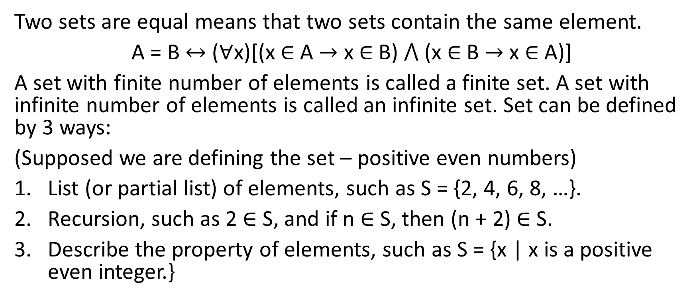
Sets and Notations
Two sets are equal means that two sets contain the same element.
A = B $↔$ ($∀$x)[(x $∈$ A $→$ x $∈$ B) $⋀$ (x $∈$ B $→$ x $∈$ A)]
A set with finite number of elements is called a finite set. A set with infinite number of elements is called an infinite set. Set can be defined by 3 ways:
(Supposed we are defining the set – positive even numbers)
List (or partial list) of elements, such as S = {2, 4, 6, 8, …}.
Recursion, such as 2 $∈$ S, and if n $∈$ S, then (n + 2) $∈$ S.
Describe the property of elements, such as S = {x | x is a positive even integer.}

Slide 7
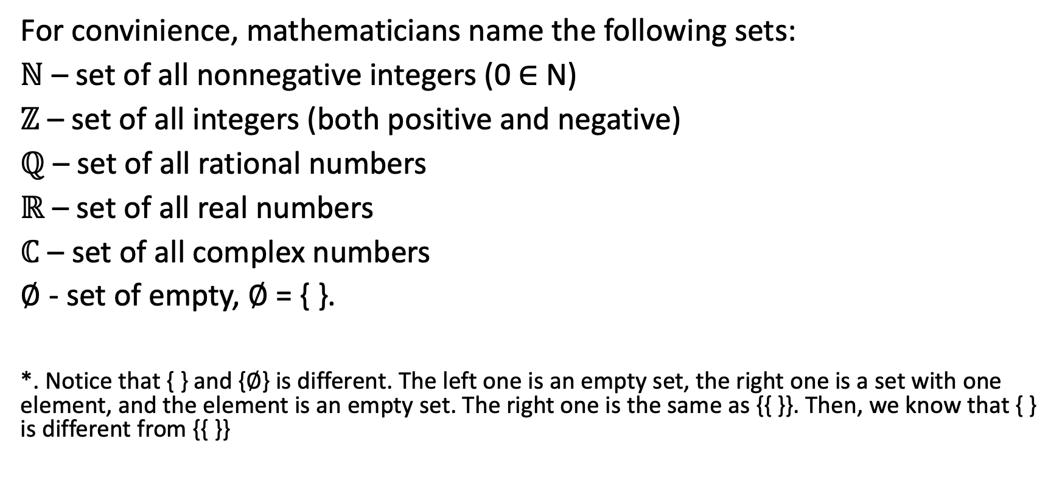
Sets of Numbers
For convinience, mathematicians name the following sets:
$ℕ$ – set of all nonnegative integers (0 $∈$ N)
$ℤ$ – set of all integers (both positive and negative)
$ℚ$ – set of all rational numbers
$ℝ$ – set of all real numbers
$ℂ$ – set of all complex numbers
∅ - set of empty, ∅ = { }.
*. Notice that { } and {∅} is different. The left one is an empty set, the right one is a set with one element, and the element is an empty set. The right one is the same as {{ }}. Then, we know that { } is different from {{ }}

Slide 8
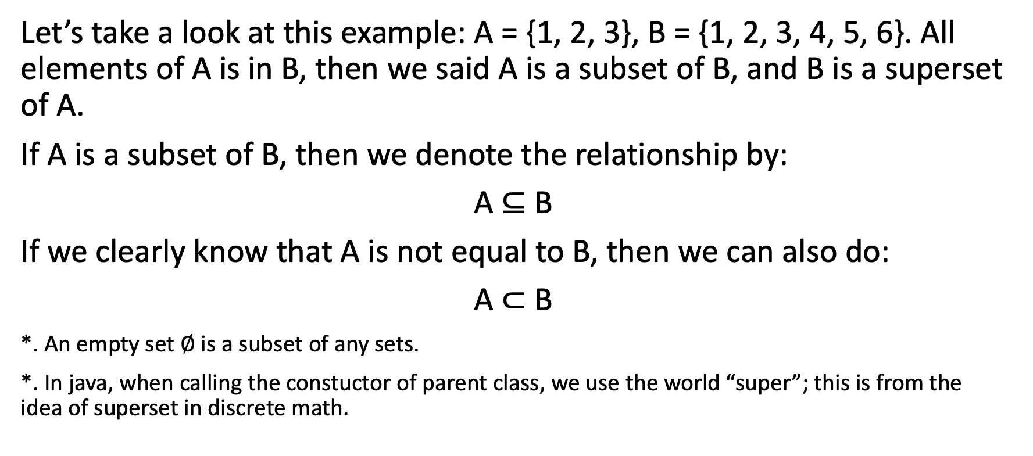
Subsets and Superset
Let’s take a look at this example: A = {1, 2, 3}, B = {1, 2, 3, 4, 5, 6}. All elements of A is in B, then we said A is a subset of B, and B is a superset of A.
If A is a subset of B, then we denote the relationship by:
A $⊆$ B
If we clearly know that A is not equal to B, then we can also do:
A $⊂$ B
*. An empty set ∅ is a subset of any sets.
*. In java, when calling the constuctor of parent class, we use the world “super”; this is from the idea of superset in discrete math.

Slide 9
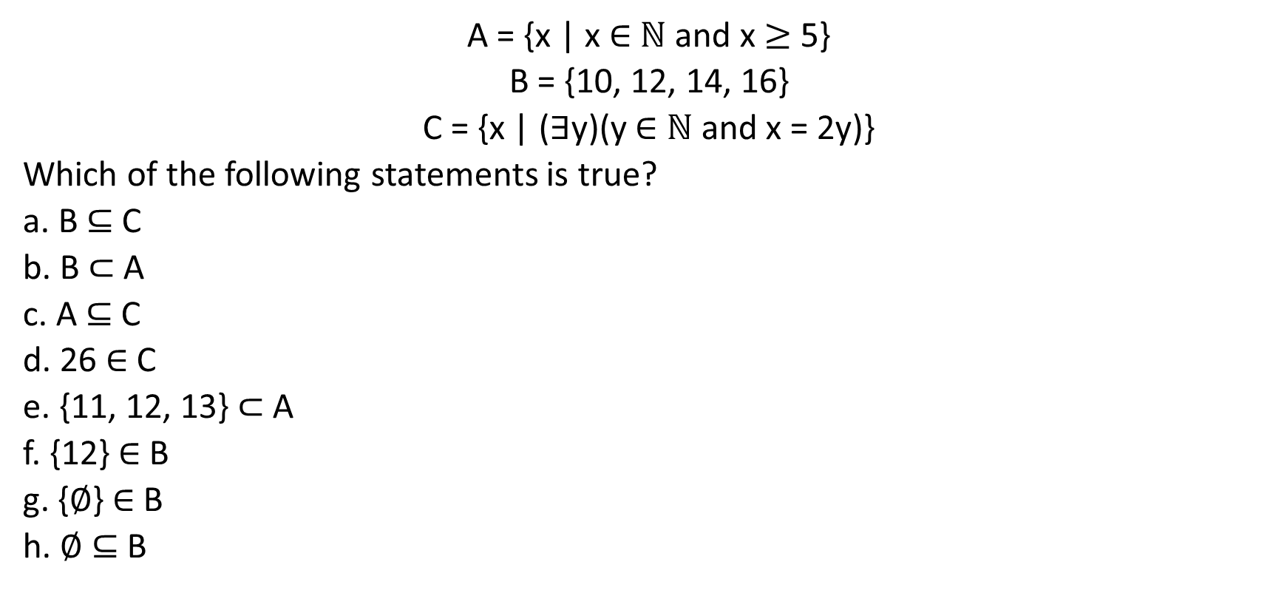
Example 4-1-1
A = {x | x $∈$ $ℕ$ and x $≥$ 5}
B = {10, 12, 14, 16}
C = {x | ($∃$y)(y $∈$ $ℕ$ and x = 2y)}
Which of the following statements is true?
a. B $⊆$ C
b. B $⊂$ A
c. A $⊆$ C
d. 26 $∈$ C
e. {11, 12, 13}$⊂$ A
f. {12} $∈$ B
g. {∅} $∈$ B
h. ∅ $⊆$ B

Slide 10
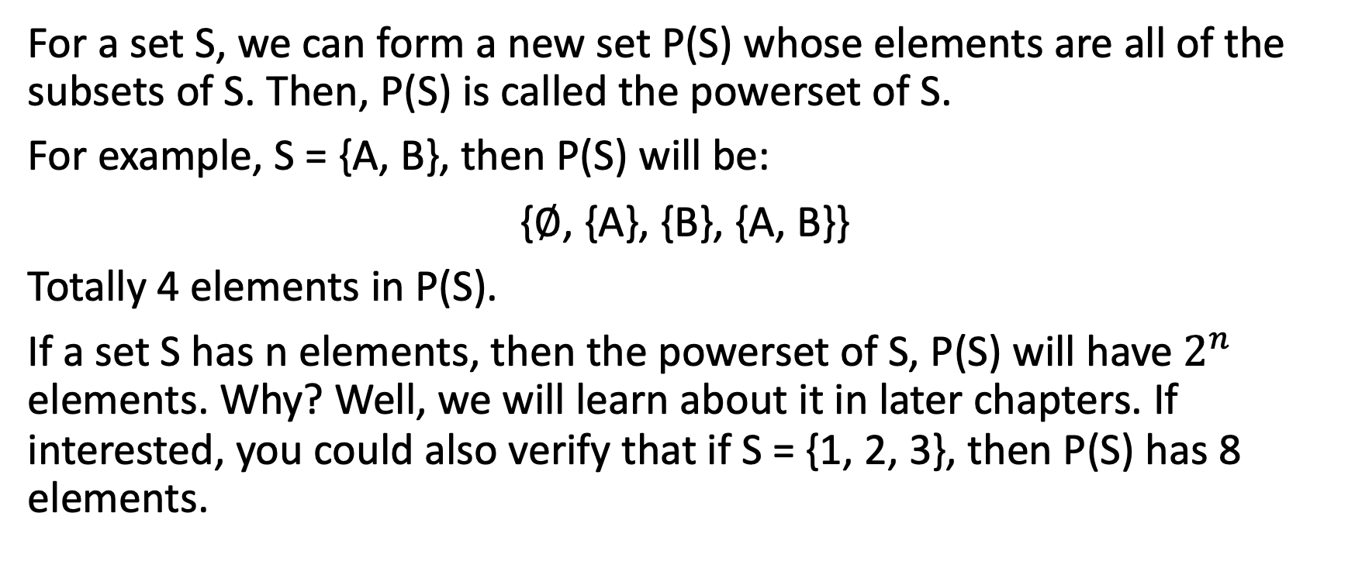
Powerset
For a set S, we can form a new set P(S) whose elements are all of the subsets of S. Then, P(S) is called the powerset of S.
For example, S = {A, B}, then P(S) will be:
{∅, {A}, {B}, {A, B}}
Totally 4 elements in P(S).
If a set S has n elements, then the powerset of S, P(S) will have $2^{n}$ elements. Why? Well, we will learn about it in later chapters. If interested, you could also verify that if S = {1, 2, 3}, then P(S) has 8 elements.

Slide 11
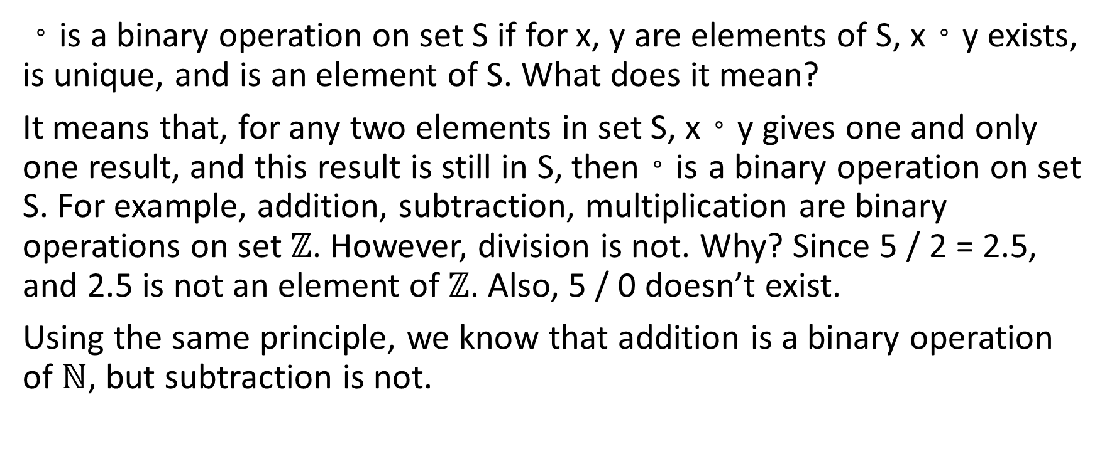
Binary and Unary Operations
。is a binary operation on set S if for x, y are elements of S, x。y exists, is unique, and is an element of S. What does it mean?
It means that, for any two elements in set S, x。y gives one and only one result, and this result is still in S, then。is a binary operation on set S. For example, addition, subtraction, multiplication are binary operations on set $ℤ$. However, division is not. Why? Since 5 / 2 = 2.5, and 2.5 is not an element of $ℤ$. Also, 5 / 0 doesn’t exist.
Using the same principle, we know that addition is a binary operation of $ℕ$, but subtraction is not.

Slide 12
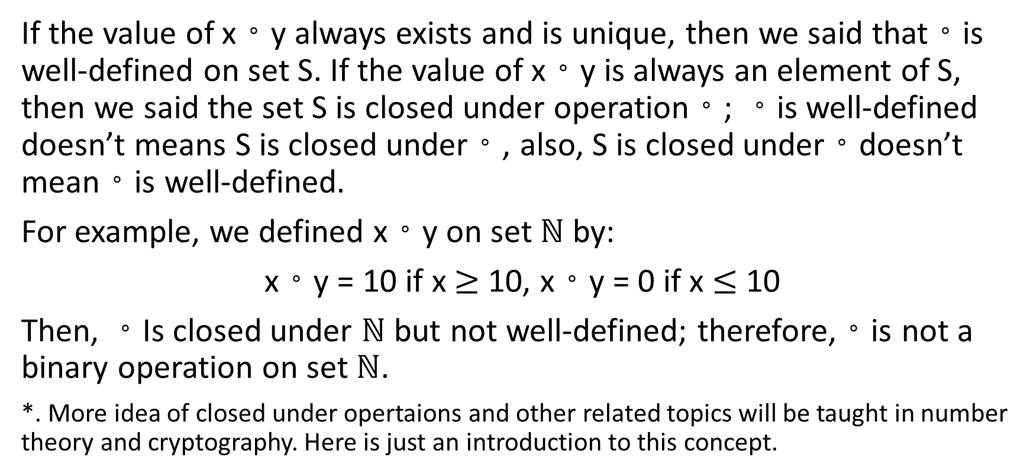
Binary and Unary Operations
If the value of x。y always exists and is unique, then we said that。is well-defined on set S. If the value of x。y is always an element of S, then we said the set S is closed under operation。; 。is well-defined doesn’t means S is closed under。, also, S is closed under。doesn’t mean。is well-defined.
For example, we defined x。y on set $ℕ$ by:
x。y = 10 if x $≥$ 10, x。y = 0 if x $≤$ 10
Then, 。Is closed under $ℕ$ but not well-defined; therefore,。is not a binary operation on set $ℕ$.
*. More idea of closed under opertaions and other related topics will be taught in number theory and cryptography. Here is just an introduction to this concept.

Slide 13
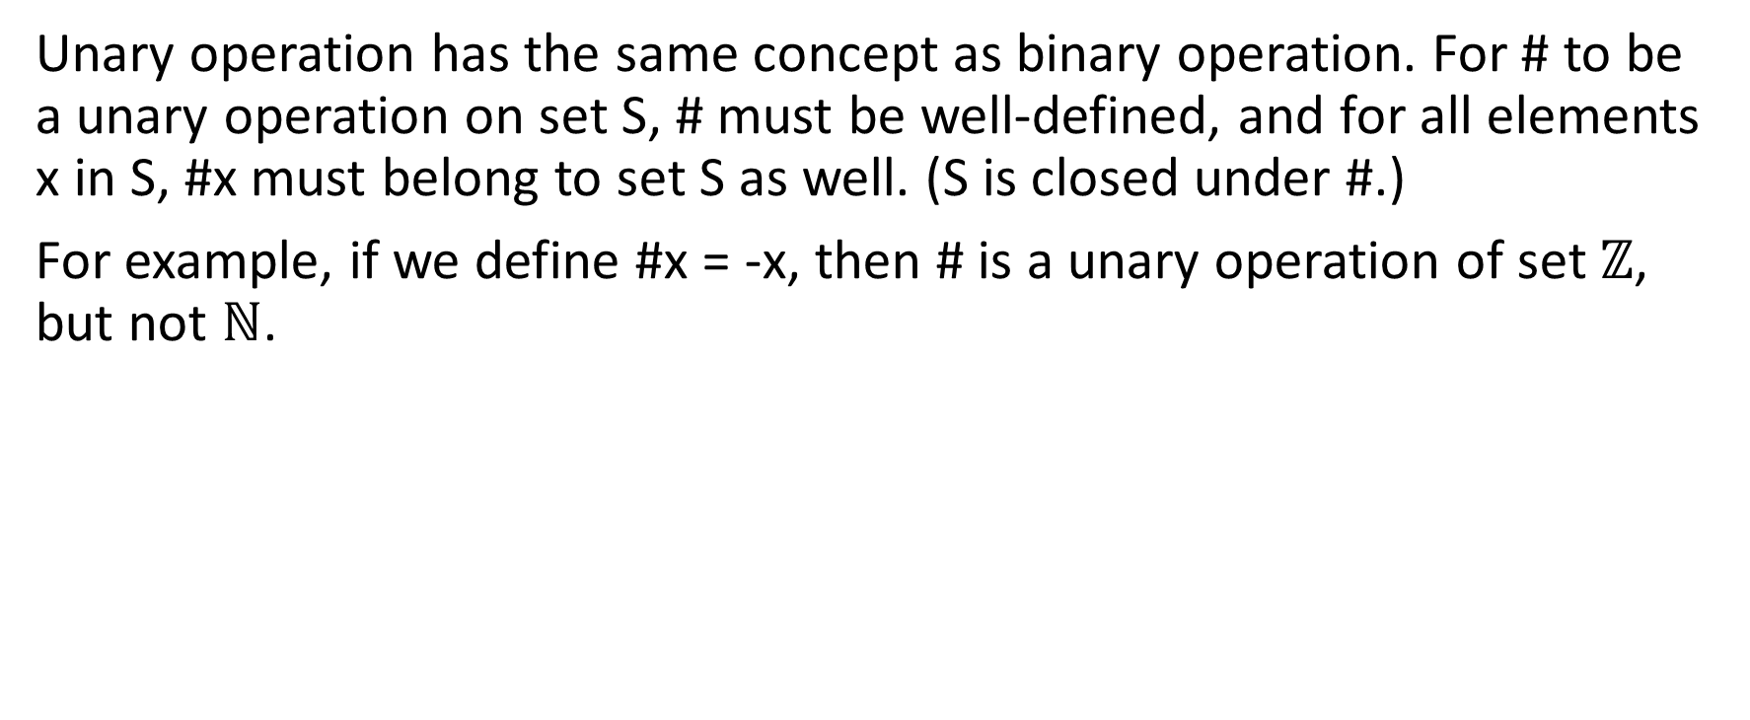
Binary and Unary Operations
Unary operation has the same concept as binary operation. For # to be a unary operation on set S, # must be well-defined, and for all elements x in S, #x must belong to set S as well. (S is closed under #.)
For example, if we define #x = -x, then # is a unary operation of set $ℤ$, but not $ℕ$.

Slide 14
Binary and Unary Operations on Sets
The binary and unary operations we have learned so far are all on numbers. Let’s expand this idea from numbers to sets.
Given a set S, we can define binary and unary operations on the powerset P(S). The following is a list of binary and unary operations we will learn:
Union and Intersection (binary)
Complement (unary)
Difference (binary)

Slide 15
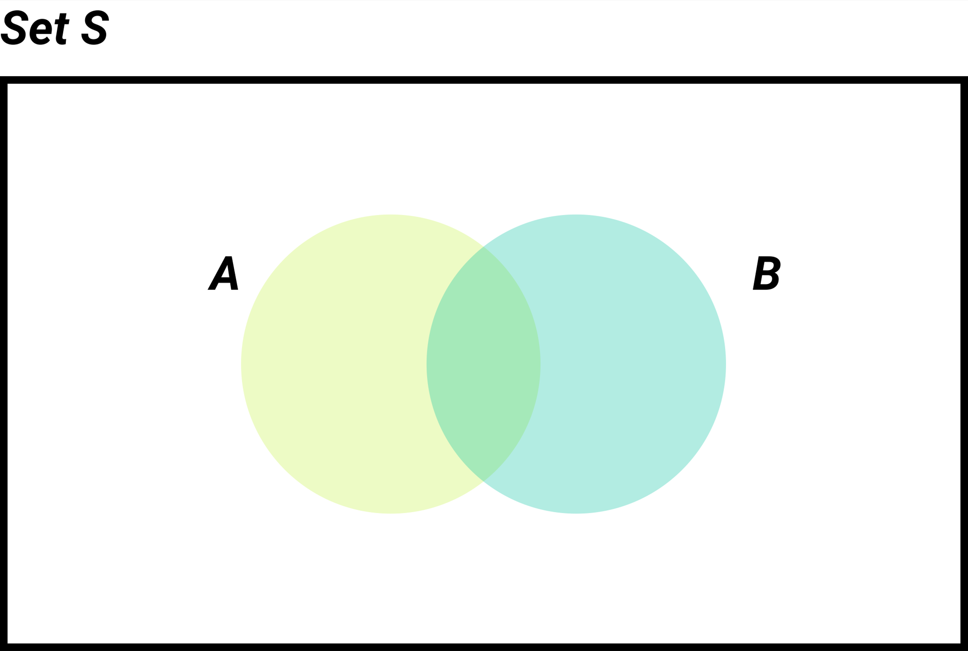
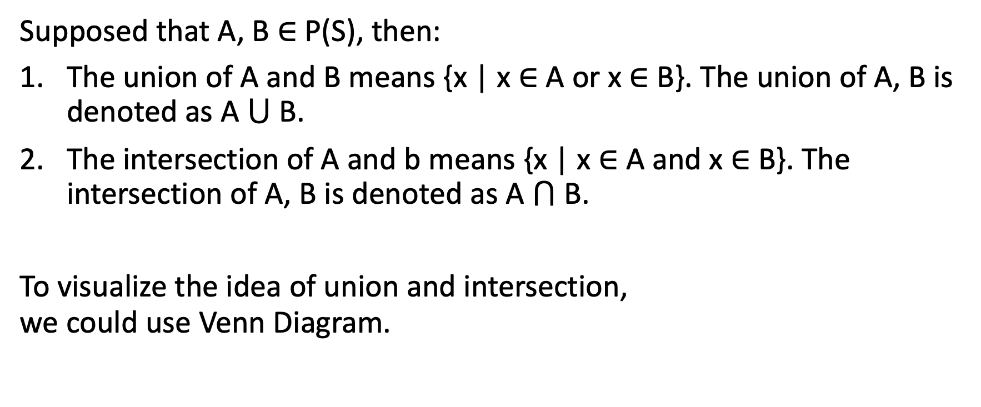
Union and Intersection
Supposed that A, B $∈$ P(S), then:
The union of A and B means {x | x $∈$ A or x $∈$ B}. The union of A, B is denoted as A $⋃$ B.
The intersection of A and b means {x | x $∈$ A and x $∈$ B}. The intersection of A, B is denoted as A $⋂$ B.
To visualize the idea of union and intersection, we could use Venn Diagram.

Slide 16
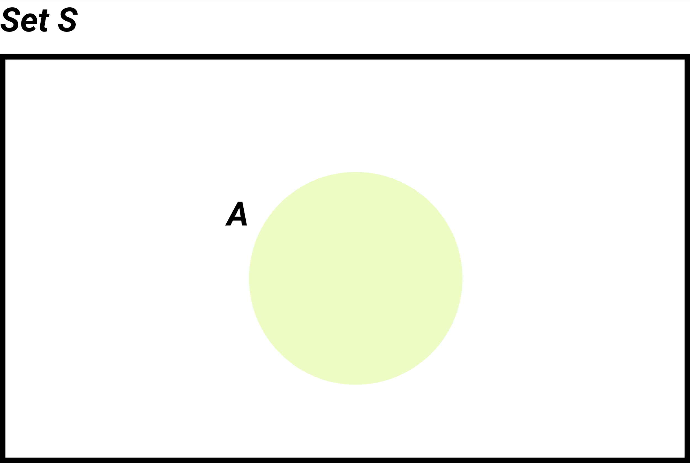
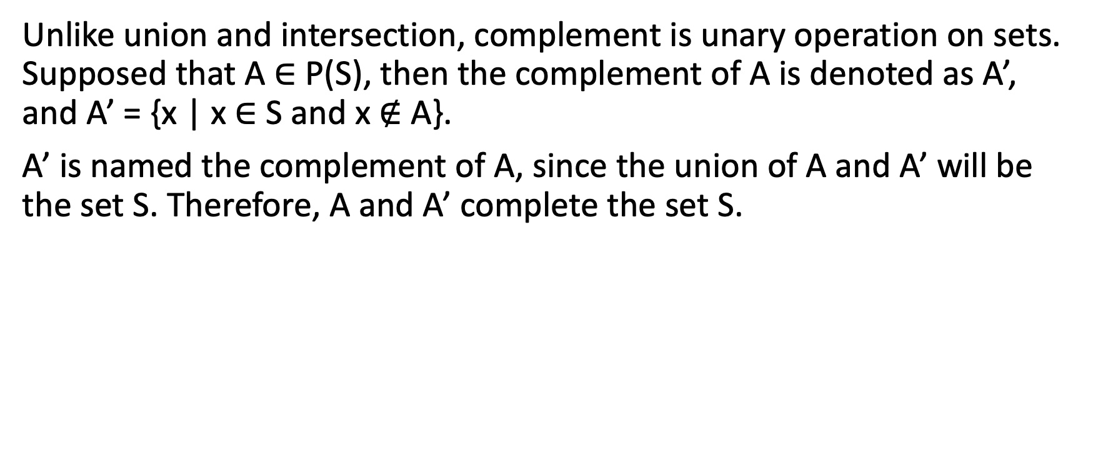
Complement
Unlike union and intersection, complement is unary operation on sets. Supposed that A $∈$ P(S), then the complement of A is denoted as A’, and A’ = {x | x $∈$ S and x $∉$ A}.
A’ is named the complement of A, since the union of A and A’ will be the set S. Therefore, A and A’ complete the set S.

Slide 17
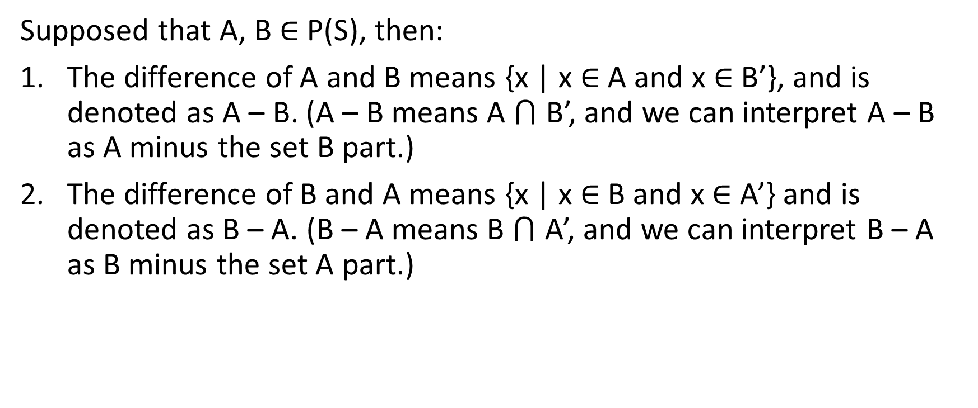
Difference
Supposed that A, B $∈$ P(S), then:
The difference of A and B means {x | x $∈$ A and x $∈$ B’}, and is denoted as A – B. (A – B means A $⋂$ B’, and we can interpret A – B as A minus the set B part.)
The difference of B and A means {x | x $∈$ B and x $∈$ A’} and is denoted as B – A. (B – A means B $⋂$ A’, and we can interpret B – A as B minus the set A part.)

Slide 18
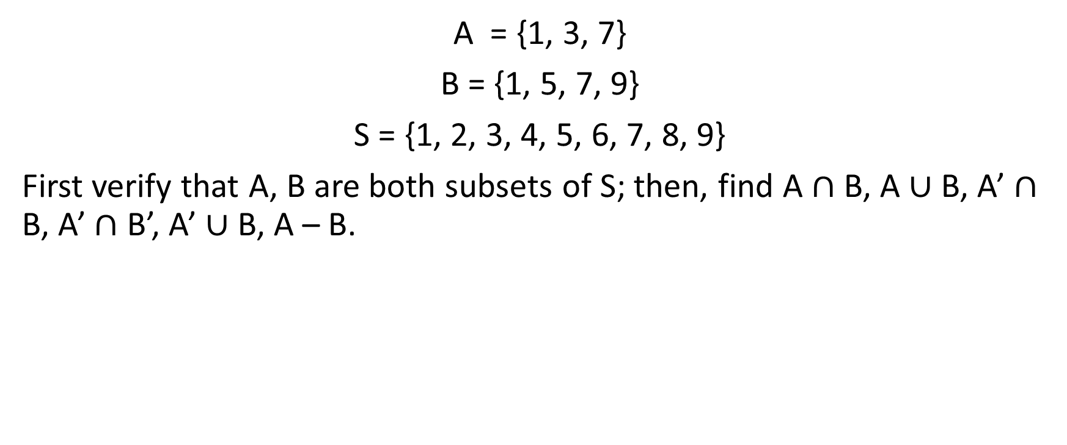
Example 4-1-2
A = {1, 3, 7}
B = {1, 5, 7, 9}
S = {1, 2, 3, 4, 5, 6, 7, 8, 9}
First verify that A, B are both subsets of S; then, find A $∩$ B, A $∪$ B, A’ $∩$ B, A’ $∩$ B’, A’ $∪$ B, A – B.

Slide 19
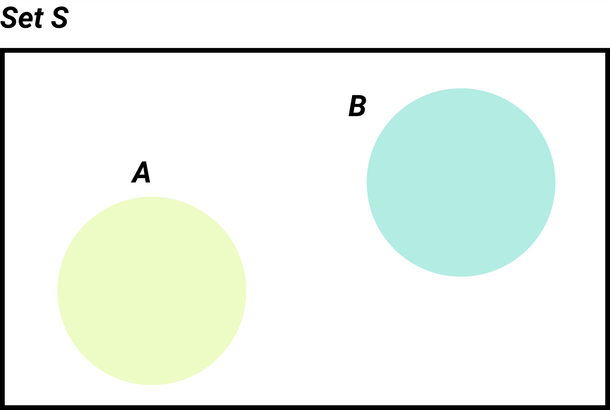
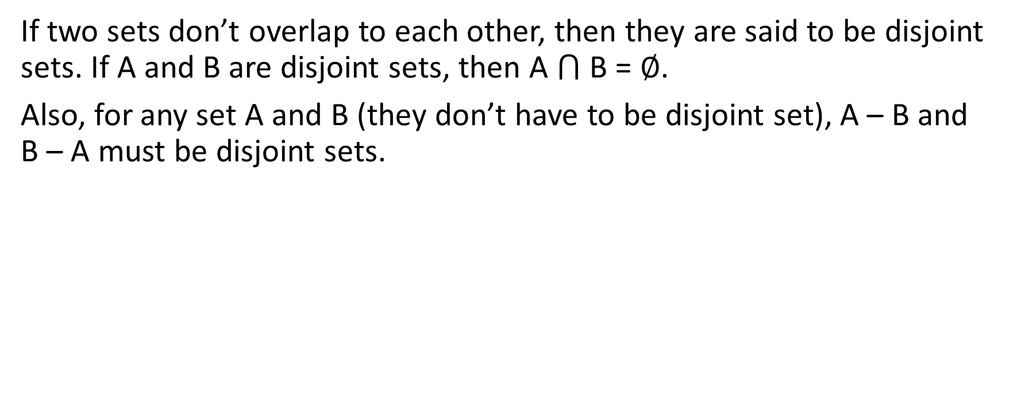
Disjoint
If two sets don’t overlap to each other, then they are said to be disjoint sets. If A and B are disjoint sets, then A $⋂$ B = ∅.
Also, for any set A and B (they don’t have to be disjoint set), A – B and B – A must be disjoint sets.

Slide 20
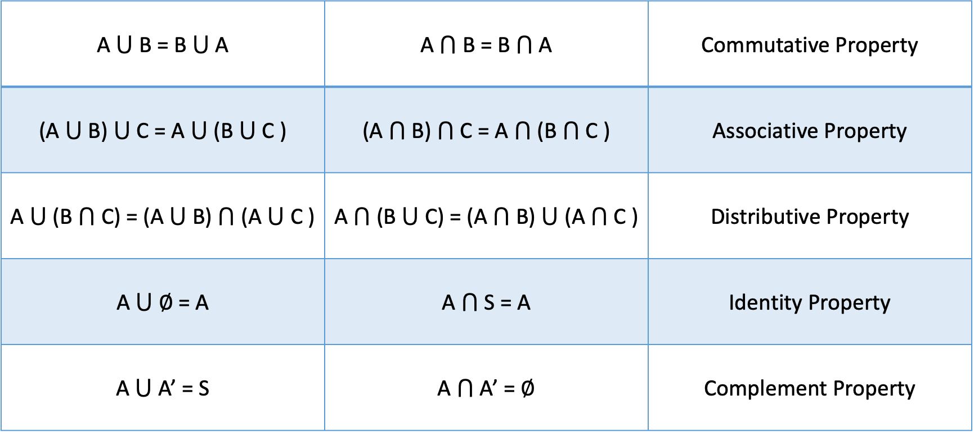
Basic Set Identities
A $⋃$ B = B $⋃$ A | A $⋂$ B = B $⋂$ A | Commutative Property
(A $⋃$ B) $⋃$ C = A $⋃$ (B $⋃$ C ) | (A $⋂$ B) $⋂$ C = A $⋂$ (B $⋂$ C ) | Associative Property
A $⋃$ (B $⋂$ C) = (A $⋃$ B)$⋂$ (A $⋃$ C ) | A $⋂$ (B $⋃$ C) = (A$⋂$ B)$⋃$ (A$⋂$ C ) | Distributive Property
A $⋃$ ∅ = A | A $⋂$ S = A | Identity Property
A $⋃$ A’ = S | A $⋂$ A’ = ∅ | Complement Property

Slide 21
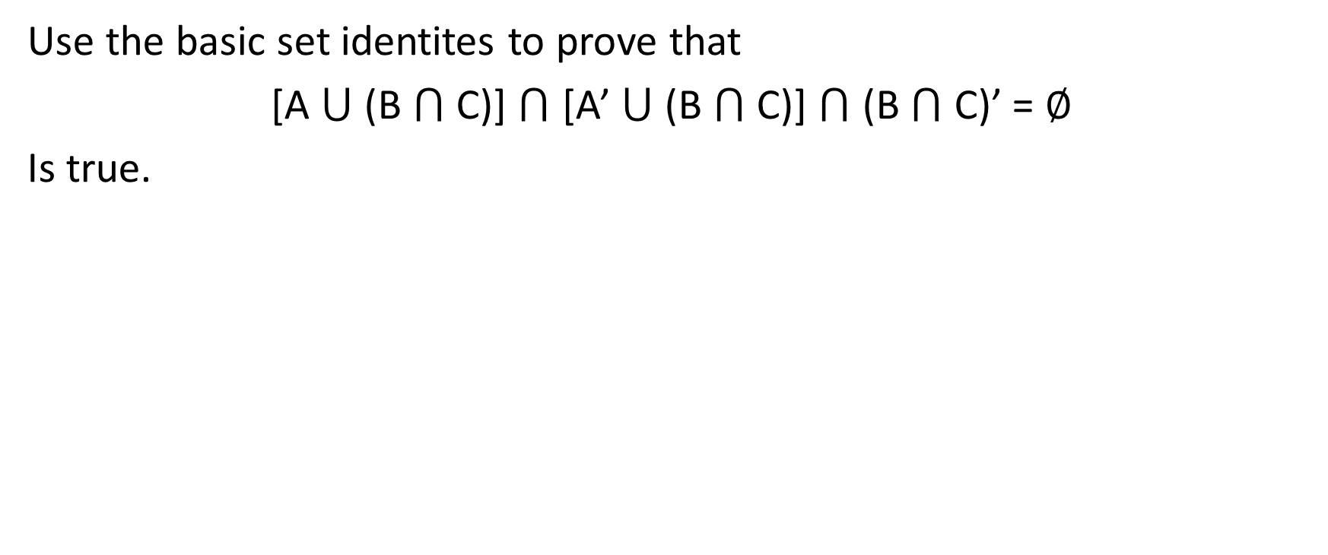
Example 4-1-3
Use the basic set identites to prove that
[A $⋃$ (B $⋂$ C)] $⋂$ [A’ $⋃$ (B $⋂$ C)] $⋂$ (B $⋂$ C)’ = ∅
Is true.

Slide 22
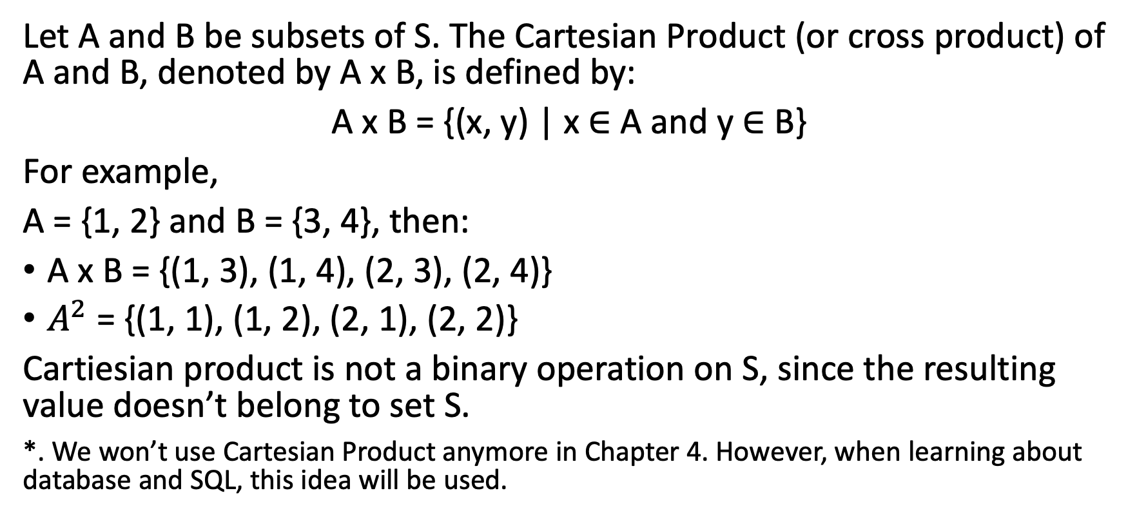
Cartesian Product
Let A and B be subsets of S. The Cartesian Product (or cross product) of A and B, denoted by A x B, is defined by:
A x B = {(x, y) | x $∈$ A and y $∈$ B}
For example,
A = {1, 2} and B = {3, 4}, then:
A x B = {(1, 3), (1, 4), (2, 3), (2, 4)}
$A^{2}$ = {(1, 1), (1, 2), (2, 1), (2, 2)}
Cartiesian product is not a binary operation on S, since the resulting value doesn’t belong to set S.
*. We won’t use Cartesian Product anymore in Chapter 4. However, when learning about database and SQL, this idea will be used.

Slide 23

4-2 Counting

Slide 24
Counting
Combinatorics is a branch of math that deals with counting. Counting is an important concept in solving problems of finite sets. (also, the resources in this world is finite; therefore, counting skill is useful)
There are two principles of counting:
Multiplication Principle
Addition Principle

Slide 25
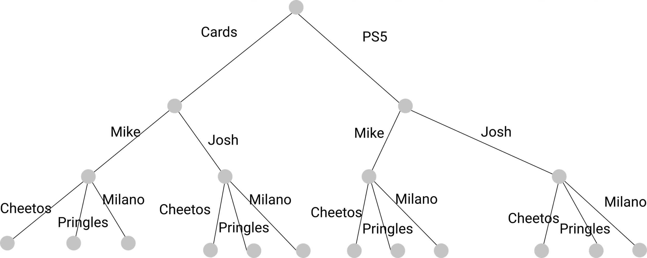
Multiplication Pinciple
Consider this example: Mike has to make 3 decisions.The first decision is to pick a game, he has 2 options – cards or PS5. The second decision is to pick a place, and he has 2 options – his house or Josh’s house. The third decision is to pick snacks, and he has 3 options – cheetos, Pringles, and Milano. How many different combination of choices can he make?
To visualize this, we can use a decision tree:

Slide 26
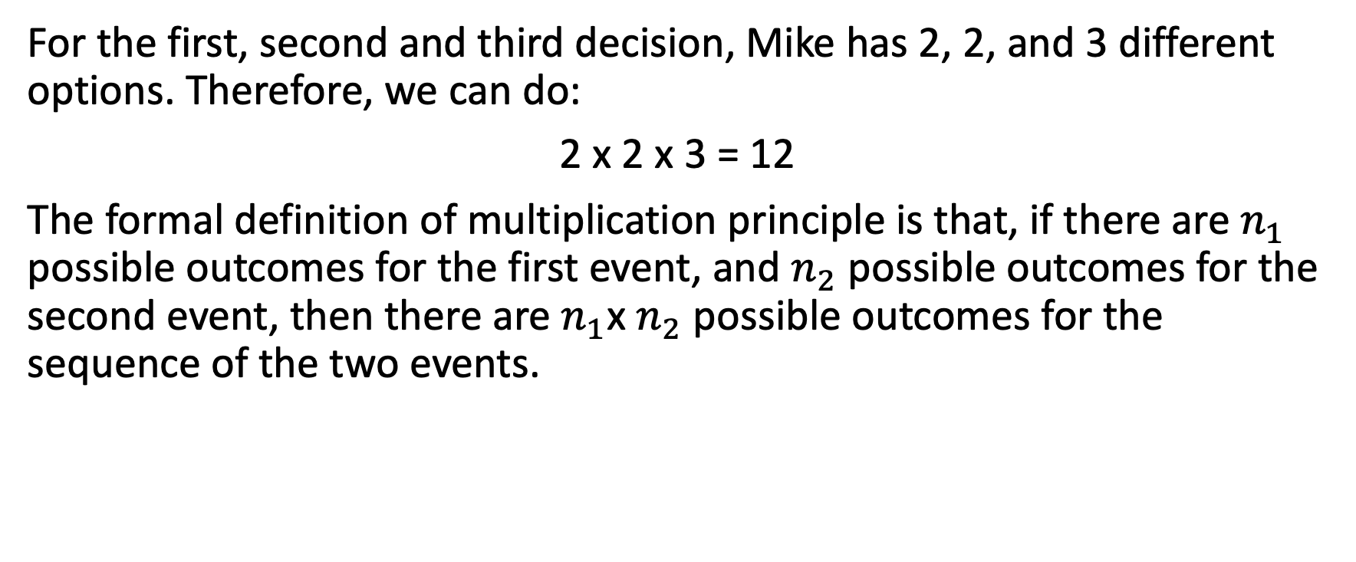
Multiplication Pinciple
For the first, second and third decision, Mike has 2, 2, and 3 different options. Therefore, we can do:
2 x 2 x 3 = 12
The formal definition of multiplication principle is that, if there are $n_{1}$ possible outcomes for the first event, and $n_{2}$ possible outcomes for the second event, then there are $n_{1}$x $n_{2}$ possible outcomes for the sequence of the two events.

Slide 27
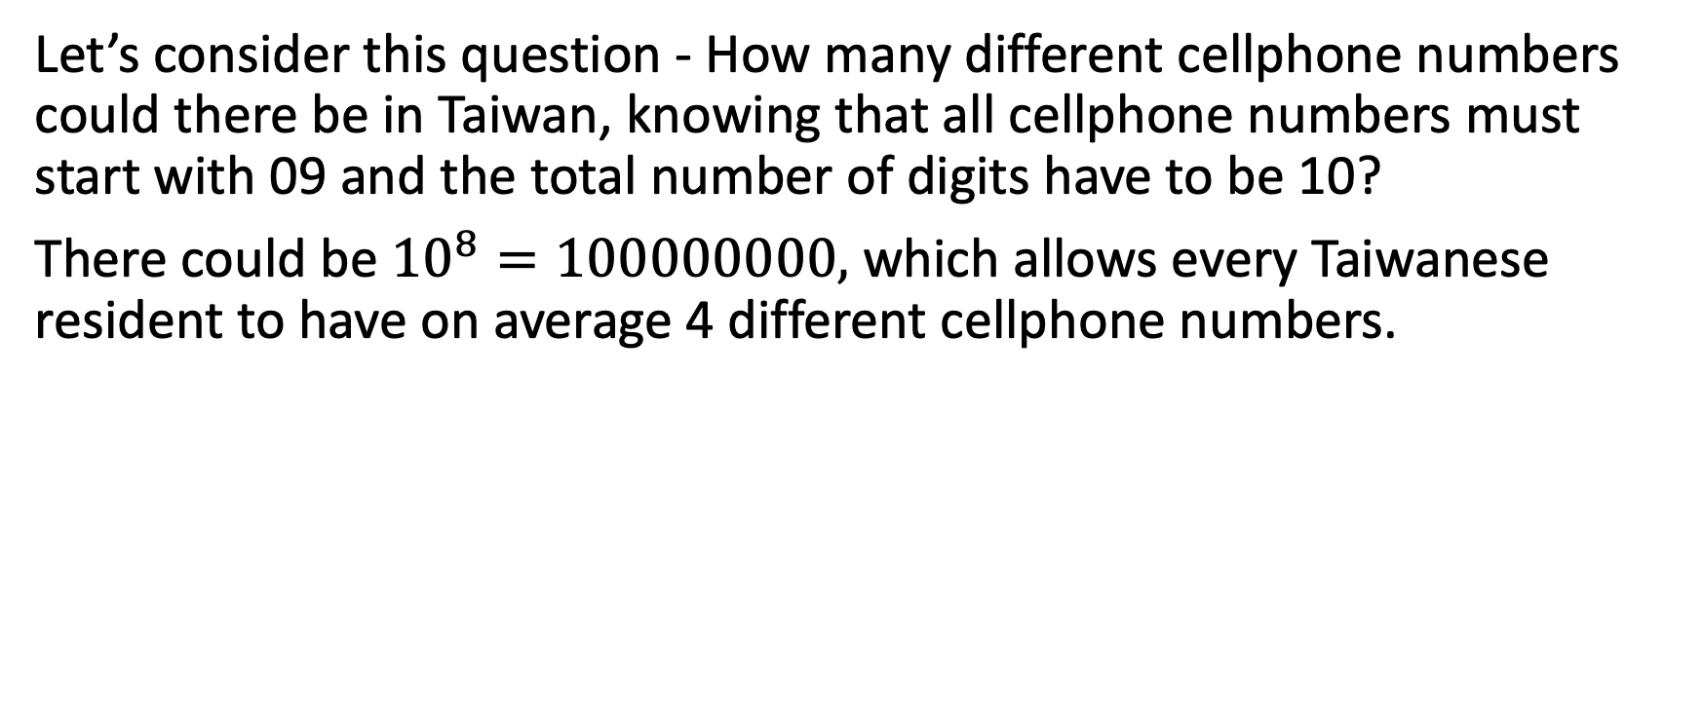
Example 4-2-1
Let’s consider this question - How many different cellphone numbers could there be in Taiwan, knowing that all cellphone numbers must start with 09 and the total number of digits have to be 10?
There could be ${10}^{8}=100000000,$ which allows every Taiwanese resident to have on average 4 different cellphone numbers.

Slide 28
Addition Principle
Let’s consider this example: Mike has a homework to do, but he wants to hang out with friends as well.
If he chooses to hang out with friends, then Mike has to make 3 decisions. The first decision is to pick a game, he has 2 options – cards or PS5. The second decision is to pick a place, and he has 2 options – his house or Josh’s house. The third decision is to pick snacks, and he has 3 options – cheetos, Pringles, and Milano.
If he chooses to do homework, then Mike has to make 2 decisions. The first decision is to pick a subject to study – Calculus or Discrete Math. The second decision to pick a place, and he has 2 options – library or school.

Slide 29
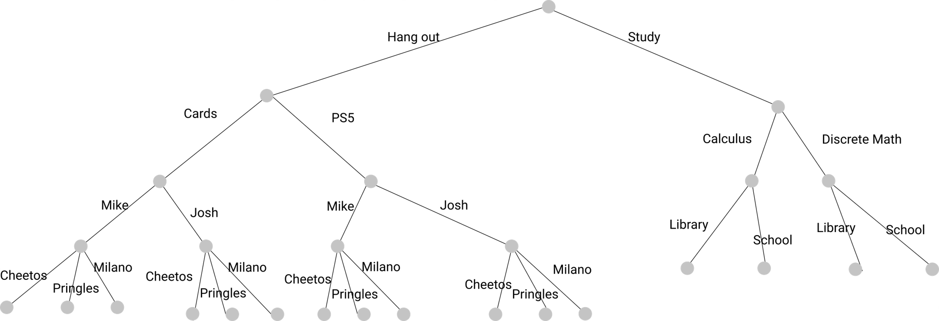
Addition Principle
Therefore, how many different choices do Mike have? Well, this can be visiualize by decision tree as well:

Slide 30
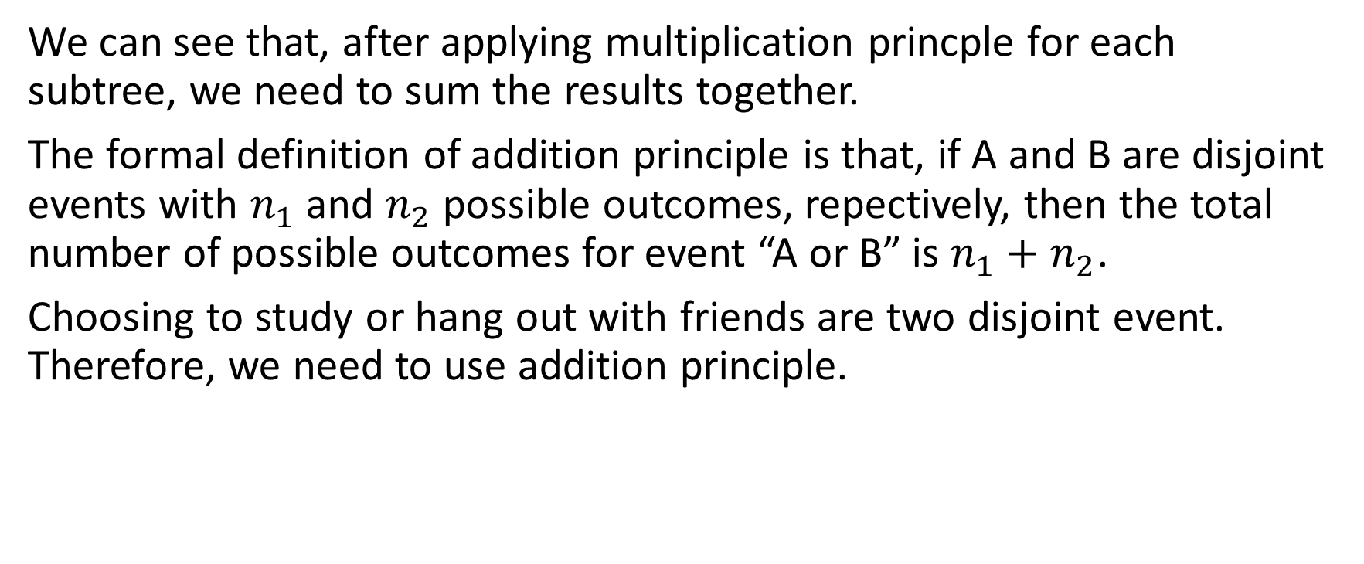
Addition Principle
We can see that, after applying multiplication princple for each subtree, we need to sum the results together.
The formal definition of addition principle is that, if A and B are disjoint events with $n_{1}$ and $n_{2}$ possible outcomes, repectively, then the total number of possible outcomes for event “A or B” is $n_{1}+n_{2}$.
Choosing to study or hang out with friends are two disjoint event. Therefore, we need to use addition principle.

Slide 31
Example 4-2-2
How many different four-digits numbers begin with 4 or 5?

Slide 32
IP Address – IPv4 and IPv6
Let’s learn about the application of counting in computer science; IPv4 address is the unique 32 bits of number assigned to each device that is connected to the internet. According to the format of IP address, how many different devices in the world can connect to the internet at the same time?
Notice that every 8 bits of number in IPv4 is transformed to an integer from 0 to 255; therefore, IPv4 looks like:
168.1.7.0
Instead of something like:
10101000.00000001.00000111.00000000
As the upper one is more human-memorable.

Slide 33
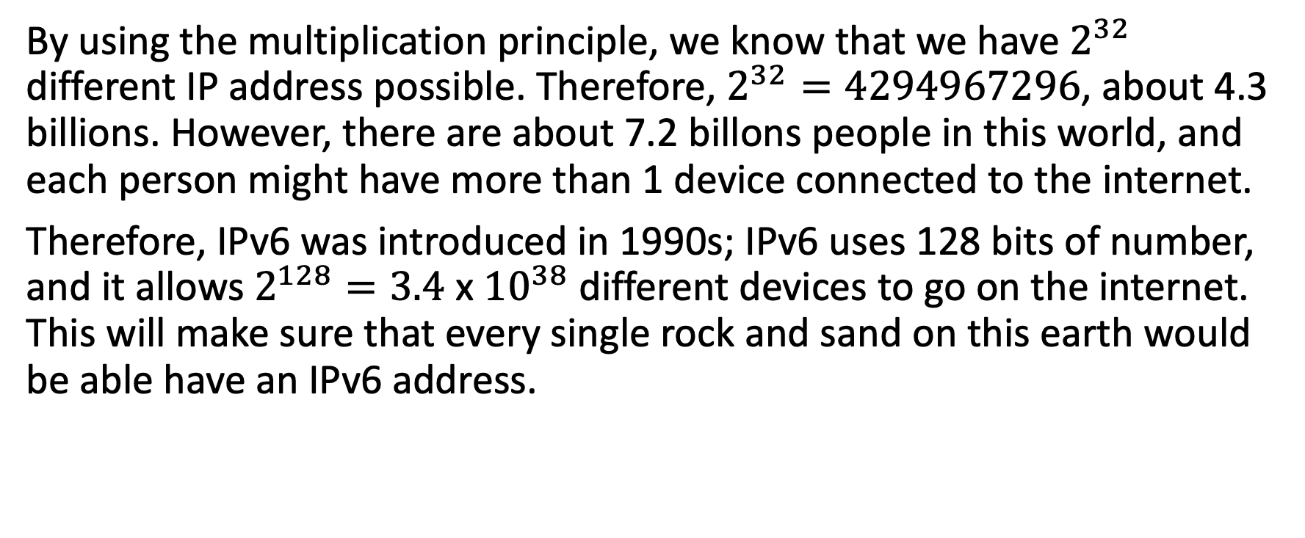
IP Address – IPv4 and IPv6
By using the multiplication principle, we know that we have $2^{32}$ different IP address possible. Therefore, $2^{32}=4294967296$, about 4.3 billions. However, there are about 7.2 billons people in this world, and each person might have more than 1 device connected to the internet.
Therefore, IPv6 was introduced in 1990s; IPv6 uses 128 bits of number, and it allows $2^{128}=3.4$ x ${10}^{38}$ different devices to go on the internet. This will make sure that every single rock and sand on this earth would be able have an IPv6 address.

Slide 34
Domain Name System
The Domain Name System (DNS) is the Internet's system for mapping alphabetic names to numeric Internet Protocol (IP) addresses. Using the www.example.com URL, example.com is the domain name, and www is the hostname.
DNS is aimed to make people memorize the domain name, instead of meaningless digits. For example, memorizing “www.youtube.com” is easier than memorizing “168.112.0.12”.
A simple DNS will be:
youtube.com | 168.112.0.15
example.com | 167.3.22.19
Google.com | 168.0.1.3

Slide 35

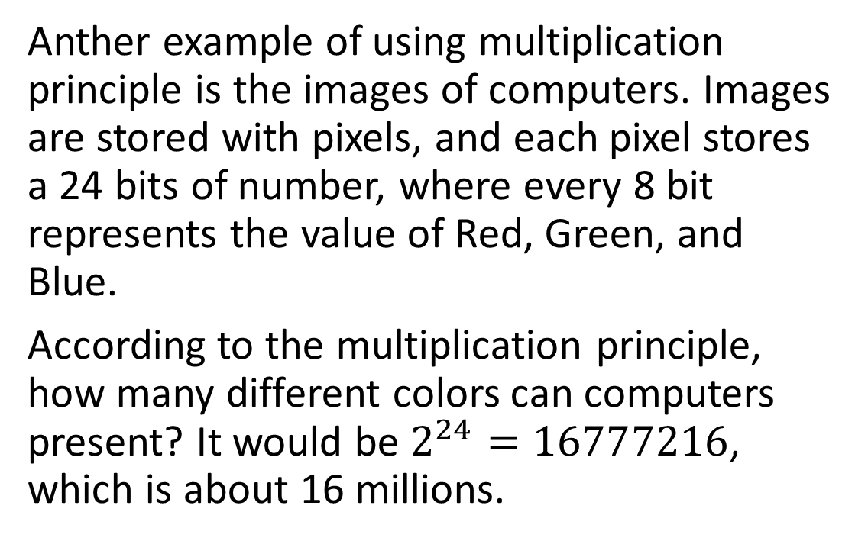
Images in Computers
Anther example of using multiplication principle is the images of computers. Images are stored with pixels, and each pixel stores a 24 bits of number, where every 8 bit represents the value of Red, Green, and Blue.
According to the multiplication principle, how many different colors can computers present? It would be $2^{24}=16777216$, which is about 16 millions.

Slide 36

4-3 Inclusive and Exclusive Principle

Slide 37
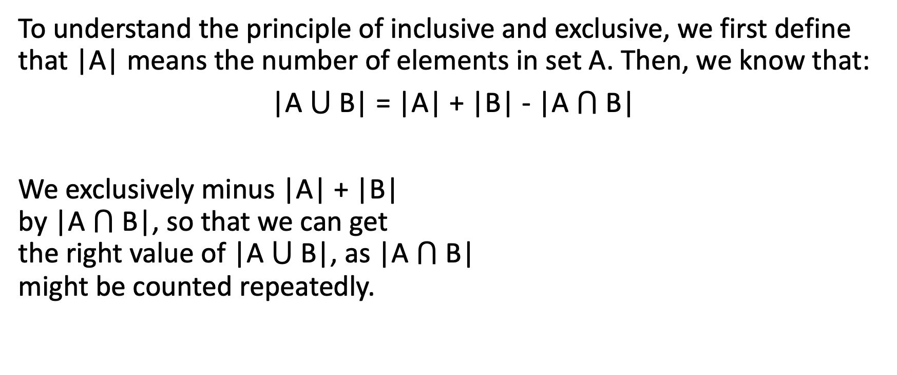
Inclusive and Exclusive Principle
To understand the principle of inclusive and exclusive, we first define that |A| means the number of elements in set A. Then, we know that:
|A $⋃$B| = |A| + |B| - |A $⋂$B|
We exclusively minus |A| + |B| by |A $⋂$B|, so that we can get the right value of |A $⋃$B|, as |A $⋂$B| might be counted repeatedly.

Slide 38
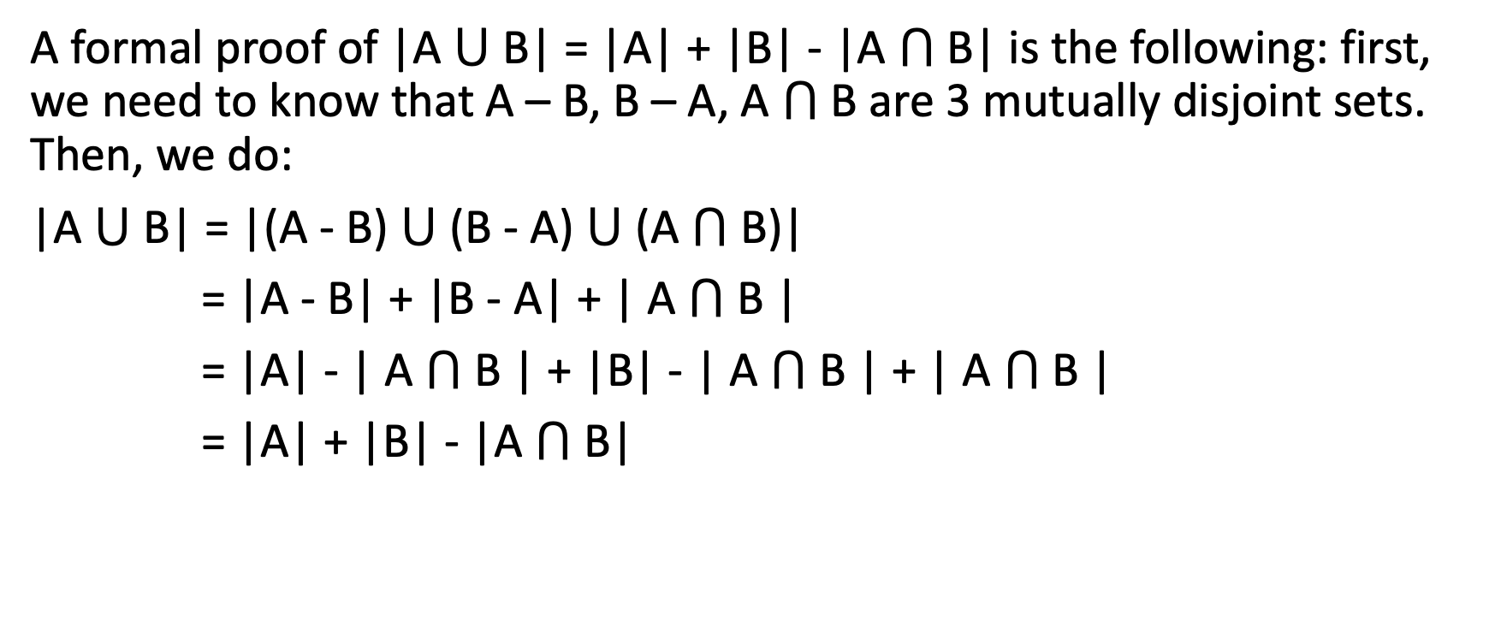
Formal Proof
A formal proof of |A $⋃$B| = |A| + |B| - |A $⋂$B| is the following: first, we need to know that A – B, B – A, A $⋂$B are 3 mutually disjoint sets. Then, we do:
|A $⋃$B| = |(A - B) $⋃$ (B - A) $⋃$(A $⋂$B)|
= |A - B| + |B - A| + | A $⋂$B |
= |A| - | A $⋂$B | + |B| - | A $⋂$B | + | A $⋂$B |
= |A| + |B| - |A $⋂$B|

Slide 39
Example 4-3-1
Supposed that among 55 random students in MIT, 15 students are Computer Science major, 17 students are Information System major, and 5 are doing double major in CS and IS. Then, how many out of 55 students are not CS nor IS major?

Slide 40
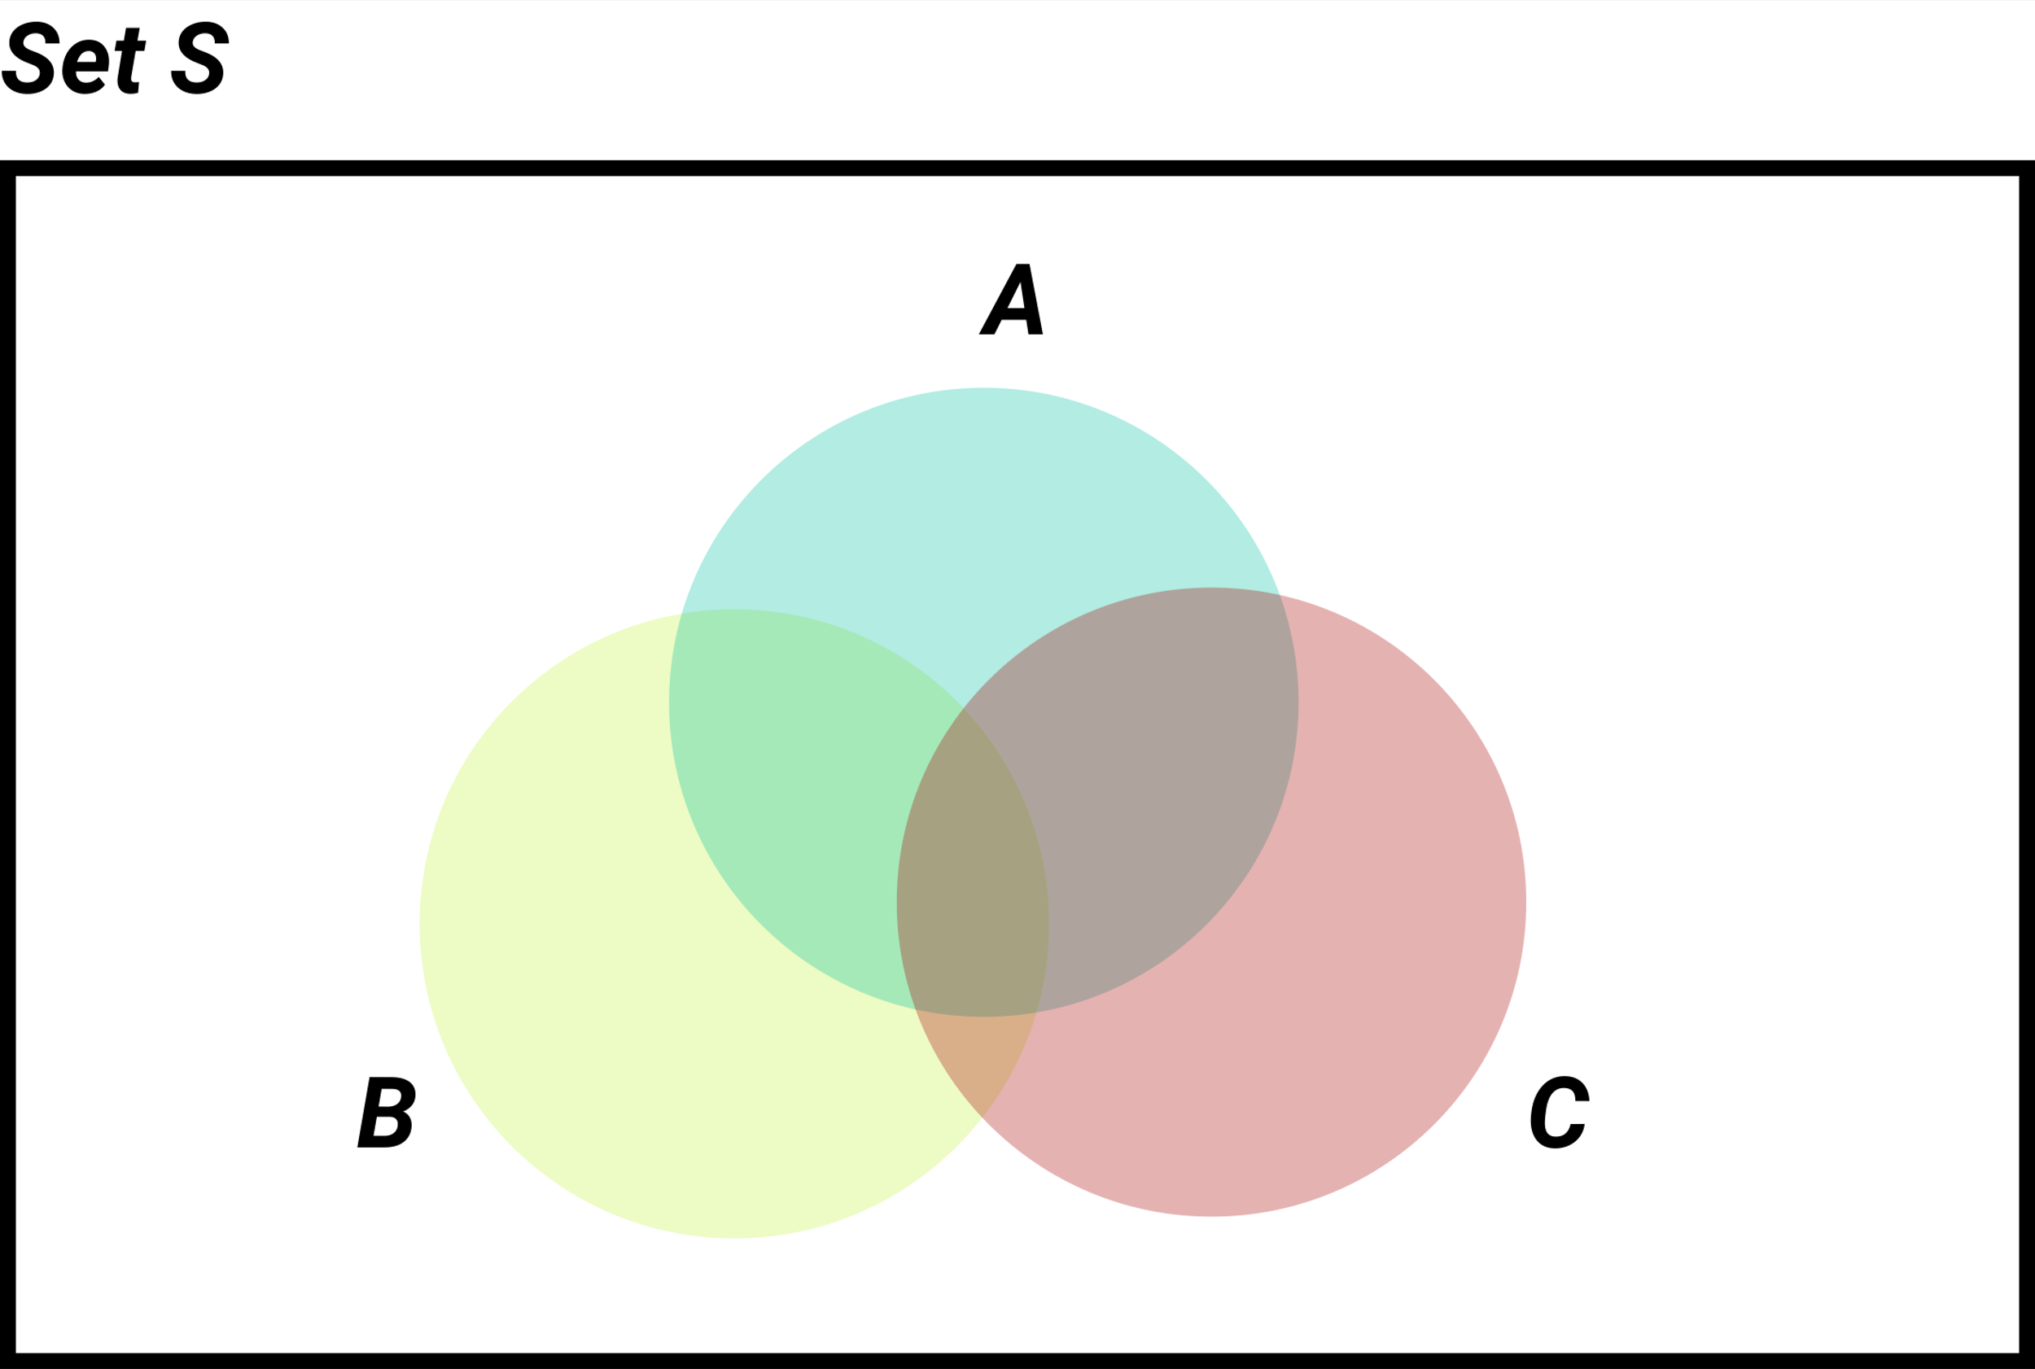
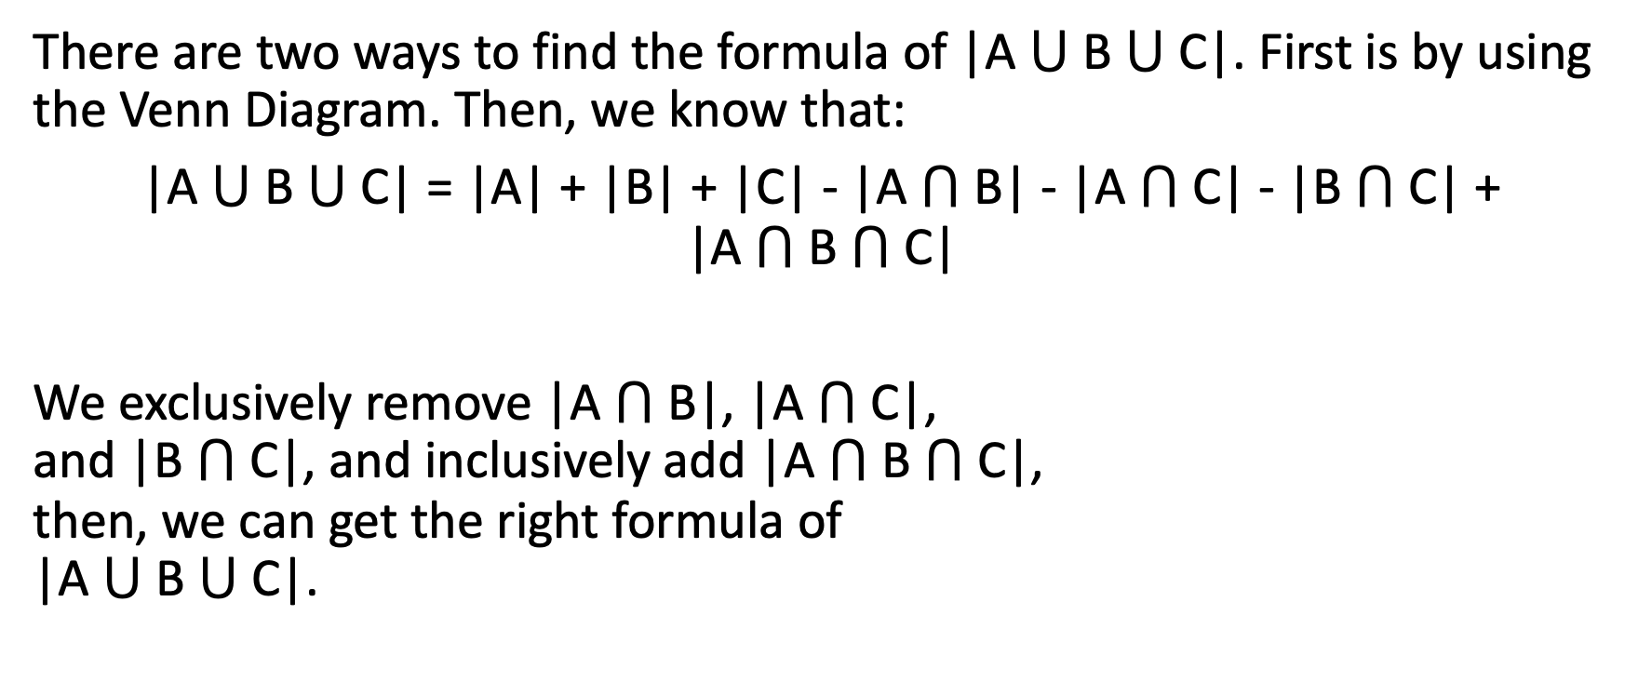
Inclusive and Exclusive Principle
There are two ways to find the formula of |A $⋃$B $⋃$C|. First is by using the Venn Diagram. Then, we know that:
|A $⋃$B $⋃$C| = |A| + |B| + |C| - |A $⋂$B| - |A $⋂$C| - |B $⋂$C| + |A $⋂$B $⋂$C|
We exclusively remove |A $⋂$B|, |A $⋂$C|, and |B $⋂$C|, and inclusively add |A $⋂$B $⋂$C|, then, we can get the right formula of |A $⋃$B $⋃$C|.

Slide 41
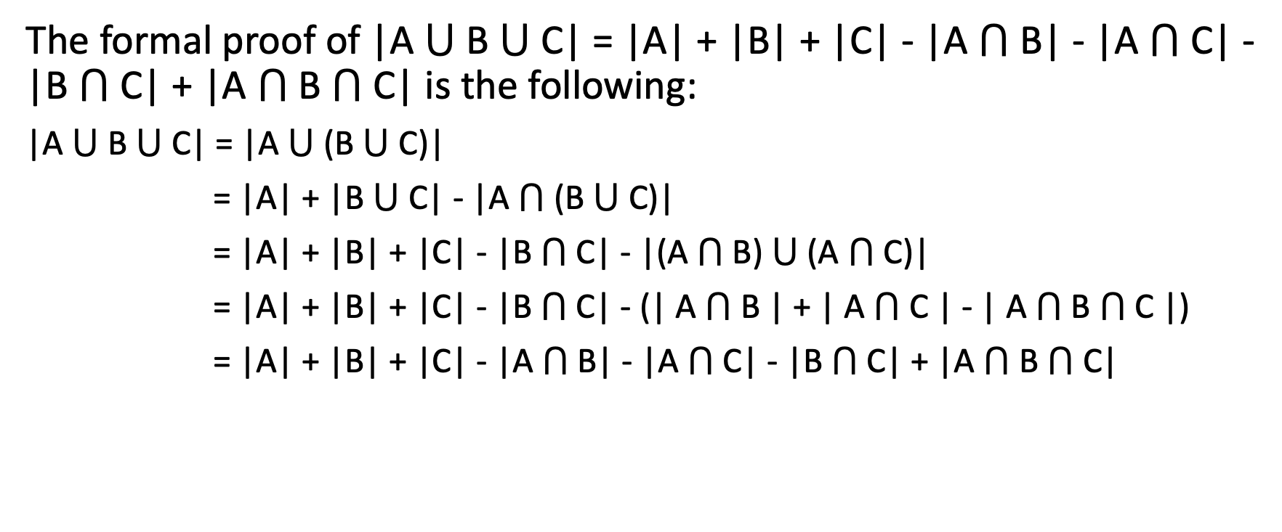
Formal Proof
The formal proof of |A $⋃$B $⋃$C| = |A| + |B| + |C| - |A $⋂$B| - |A $⋂$C| - |B $⋂$C| + |A $⋂$B $⋂$C| is the following:
|A $⋃$B $⋃$C| = |A $⋃$(B $⋃$ C)|
= |A| + |B $⋃$C| - |A $⋂$(B $⋃$C)|
= |A| + |B| + |C| - |B $⋂$C| - |(A $⋂$ B) $⋃ \text{(}\text{A} ⋂ \text{C}\text{)}$|
= |A| + |B| + |C| - |B $⋂$C| - (| A $⋂$ B | + | $\text{A} ⋂ \text{C}$| - | A $⋂$ B $⋂ \text{C}$ |)
= |A| + |B| + |C| - |A $⋂$B| - |A $⋂$C| - |B $⋂$C| + |A $⋂$B $⋂$C|

Slide 42
Example 4-3-2
Among all numbers from 1 to 120, how many of them are multiples of 2, 3, or 5?

Slide 43
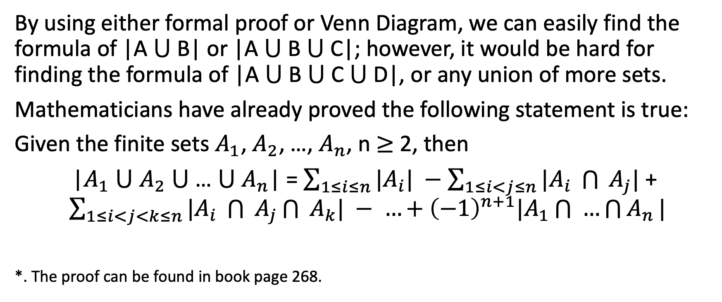
On Inclusion and Exclusion
By using either formal proof or Venn Diagram, we can easily find the formula of |A $⋃$B| or |A $⋃$B $⋃$C|; however, it would be hard for finding the formula of |A $⋃$B $⋃$C $⋃$D|, or any union of more sets.
Mathematicians have already proved the following statement is true:
Given the finite sets $A_{1}$, $A_{2}$, …, $A_{n}$, n $≥$ 2, then
|$A_{1}$ $⋃$ $A_{2}$ $⋃$ … $⋃$ $A_{n}$| =$\sum_{1≤i≤n}{|A_{i}|} −$ $\sum_{1≤i<j≤n}{|A_{i} \bigcap{ }A_{j}|}$ + $\sum_{1≤i<j<k≤n}{|A_{i} \bigcap{ }A_{j}\bigcap{ }A_{k}|} − …+{\left(−1\right)}^{n+1}|A_{1}\bigcap{ }…\bigcap{A_{n}}|$
*. The proof can be found in book page 268.

Slide 44
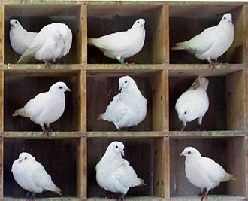
Pigeonhole Principle
The pigeonhole principle is a simple idea – if more than k items are placed into k bins, then at least 1 bin contains more than 1 item.
If more than k pigeons fly into k pigeonholes, then at least one hole would contain more than 1 pigeon.

Slide 45
Pigeonhole Principle Application
How many people must be in a room to guarantee that 2 people have last names that begin with the same initial? We need 27 people.
How many times must a single die be rolled to guarantee getting the same value twice? 7 times.
How is it related to Computer Science?
The pigeonhole principle is used in determining the size of hashtable. Hashtable is a common data structure that is constantly fast in getting data from database. As the size of database grows, the time of getting data out will not grow (sounds like a magic, doesn’t it?)
Most of the programming langauge has built-in hashtable, for example, java hashmap, JavaScript arrays and objects are hashed, python dictionaries, and many others.

Slide 46

4-4 Permutations and Combinations

Slide 47
Permutations
An ordered arrangement of objects is called a permutation. Supposed we have a set of 4 objects, {A, B, C, D}. Then, how many different permutations could there be?
Let’s consider a simpler case: just {A}. Then, there’s only 1 permutation. What about {A, B}? There’s {A, B} and {B, A}, 2 permutations. What about {A, B, C}? {A, B, C}, {A, C, B}, {B, A, C}, {B, C, A}, {C, A, B}, {C, B, A} total 6 permutatios.
Is there a better technique, than other simply enumerating all possiblities?

Slide 48
Permutations
When couning {A, B, C}, we can think of this as the following:
In case of A is the first element, we have {B, C} to perform permutation. Therefore, we have 2 permutations. In case of B is the first element, we have {A, C}; therefore, we have 2 permutations. In case of C is the first element, we have {A, B}; therefore, we have 2 permutations. The total is 6.
When counting {A, B, C, D}, we know that each element of {A, B, C, D} could be the first element. Then, the remaining 3 elements have 6 different permutations. Therefore, the total possible permutation is 4 x 6 = 24. (or more precisely, 4 x 3 x 2 x 1 = 24)

Slide 49

Permutations
N factorial is defined as n! = n x (n - 1) x (n - 2) x … x 3 x 2 x 1; then, we know that, if we have a set of n items, then the total possible different permutations would be n!.
What if we have a set of n items, and we take 4 distinct elements of this set, then how many possible different permutations could there be?

Slide 50
Permutations
This can be interpreted as a multiplication principle problem. We have to make 4 decisions.
For the first decision, we need to pick one item from n items. For the second decision, we need to pick one item from n – 1 items. For the third and fourth decision, we need to pick n – 2 and n – 3 items.
Therefore, the possible permutation is:
n x (n - 1) x (n -2) x (n -3)

Slide 51
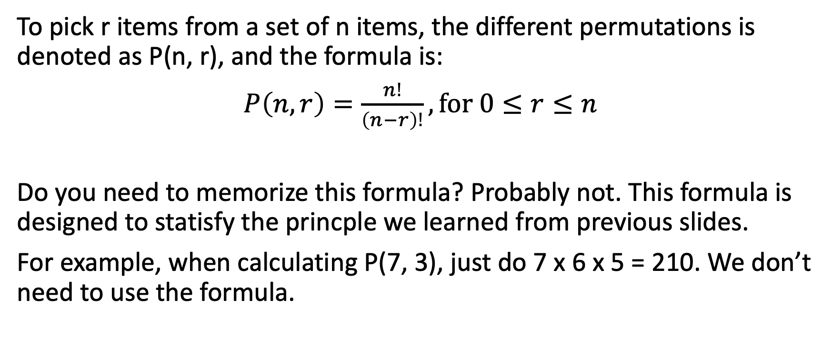
Permutations
To pick r items from a set of n items, the different permutations is denoted as P(n, r), and the formula is:
$P\left(n, r\right)=\frac{n!}{\left(n−r\right)!}, for 0≤r≤n$
Do you need to memorize this formula? Probably not. This formula is designed to statisfy the princple we learned from previous slides.
For example, when calculating P(7, 3), just do 7 x 6 x 5 = 210. We don’t need to use the formula.

Slide 52
Example 4-4-1
Let’s learn the properties of factorial and permutations by the following 3 examples:
1. P(n, 1), which means to pick one elenent from n elements to do permutation, how many possible permutations there are?
2. P(n, 0), which means we don’t take any element from n elements to do permutation, then how many possible permutations there are? (The answer is not 0)
3. P(n, n) which means we take all elements from n elements to do permutation, then how many possible permutations there are?

Slide 53
Combinations
Sometimes we want to select r objects from a set of n elements, but we don’t care about the order; therefore, the distincet ways of selecting r objects from n elements is called the combinations of r objects, and is denoted by C(n, r).
However, how do we count the total possible ways of combinations? Let’s consider a simple example – supposed we have a set {A, B, C}, and we want to take 2 elements out from this set.
Permutations tells us that there are 3 x 2 = 6 different permutations; they are {A, B}, {A, C}, {B, A}, {B, C}, {C ,A}, {C, B}. However, the key difference between combination and permutation is – combinations doesn’t care about the orders.

Slide 54
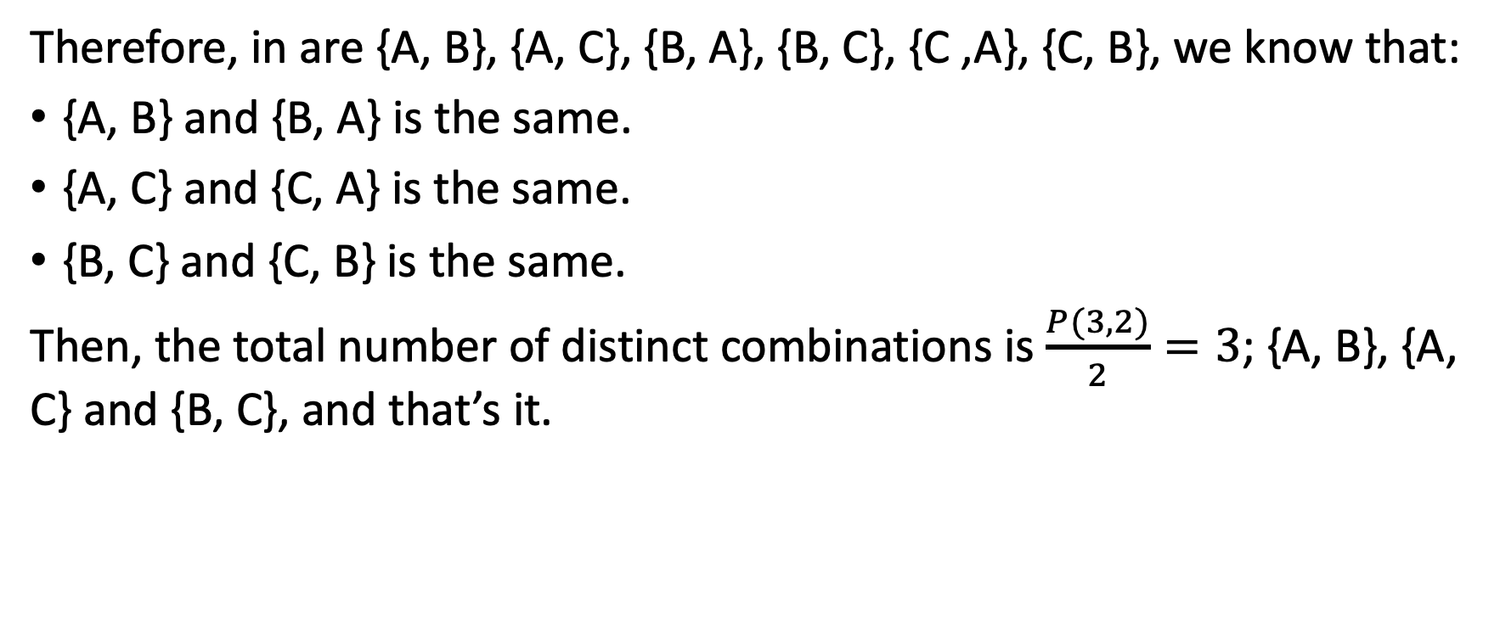
Combinations
Therefore, in are {A, B}, {A, C}, {B, A}, {B, C}, {C ,A}, {C, B}, we know that:
{A, B} and {B, A} is the same.
{A, C} and {C, A} is the same.
{B, C} and {C, B} is the same.
Then, the total number of distinct combinations is $\frac{P(3, 2)}{2}=3$; {A, B}, {A, C} and {B, C}, and that’s it.

Slide 55
Combinations
Now, we can start to analyze the formula of combinations. Let’s consider this slightly more complex example: supposed we have a set {A, B, C, D}, and we take 3 elements to do combinations. How many different distinct combinations are there?
Well, we should do permutations first. We know there will be P(4, 3) = 4 x 3 x 2 x 1 = 24 distinct permutations. However, in this 24 permutations, many of them can be combined into one distinct combination. For example:
{A, B, C}, {A, C, B}, {B, A, C}, {B, C, A}, {C, A, B}, {C, B, A}
will be counted as 1 combination.

Slide 56
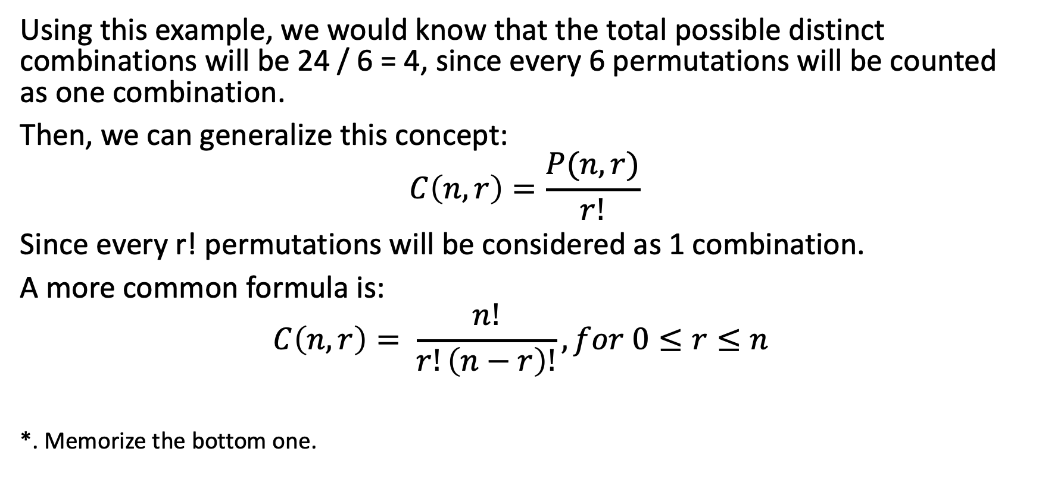
Combinations
Using this example, we would know that the total possible distinct combinations will be 24 / 6 = 4, since every 6 permutations will be counted as one combination.
Then, we can generalize this concept:
$$C\left(n, r\right)=\frac{P(n, r)}{r!}$$
Since every r! permutations will be considered as 1 combination.
A more common formula is:
$$C\left(n, r\right)= \frac{n!}{r!\left(n−r\right)!}, for 0≤r≤n$$
*. Memorize the bottom one.

Slide 57
Example 4-4-2
1. C(n, 1), which means to pick one elenent from n elements to do combinations, how many possible combinations there are?
2. C(n, 0), which means we don’t take any element from n elements to do combinations, then how many possible combinations there are? (The answer is not 0, as you might guess)
3. C(n, n) which means we take all elements from n elements to do combinations, then how many possible combinations there are? (Without calculating, you might already know the answer)
4. Consider this question – are C(n, r) and C(n, n-r) the same? Do not calculate the value, just think about the meaning behind it.

Slide 58
Example 4-4-3
How many 5-card poker hands are possible with a 52-card deck? (The order of cords doesn’t matter, since we simply want to know which cards end up in our hands.)

Slide 59
Example 4-4-4
A committee of 8 students is to be formed from a set of 19 freshmen and 34 sophomores. Then,
How many committes of exactly 3 freshmen and 5 sophomores are possible?
How many committes of exactly 1 freshmen are possible?
How many committes of at most 1 freshman are possible? (We can have no freshman or exactly one freshman. This two combinations are disjoint event)
How many committes of at least 1 freshman are possible? (All cases are possible after removing the cases when we don’t have any freshman in the committee)

Slide 60
Permutation with Repetition
Until now, the sets we are working on don’t have duplicate elements. Now, let’s consider this problem – how many different permutations can be made from the word “MISSISSIPPI”?
We could enumerate all possible permutations, but it would be extremely hard, as we might miss some possible permutations. Therefore, there has to be a mathematical way to figure this out.
Let’s consider an simple example – how many different permutations can be made from “AAB”? We know there are “AAB”, “ABA”, and “BAA”; total 3 different permutations.

Slide 61
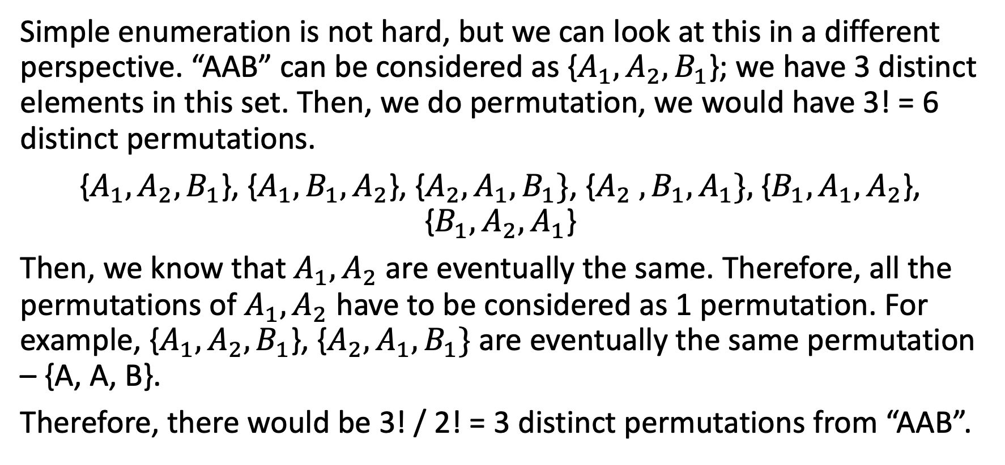
Permutation with Repetition
Simple enumeration is not hard, but we can look at this in a different perspective. “AAB” can be considered as {$A_{1},A_{2},B_{1}$}; we have 3 distinct elements in this set. Then, we do permutation, we would have 3! = 6 distinct permutations.
{$A_{1},A_{2},B_{1}$}, {$A_{1},B_{1},A_{2}$}, {$A_{2}, A_{1},B_{1}\}$, {$A_{2} ,B_{1}, A_{1}\},${${B_{1}, A}_{1},A_{2}$}, {${B_{1},A_{2}, A}_{1}$}
Then, we know that $A_{1},A_{2}$ are eventually the same. Therefore, all the permutations of $A_{1}, A_{2}$ have to be considered as 1 permutation. For example, {$A_{1},A_{2},B_{1}$}, {$A_{2}, A_{1},B_{1}\}$ are eventually the same permutation – {A, A, B}.
Therefore, there would be 3! / 2! = 3 distinct permutations from “AAB”.

Slide 62
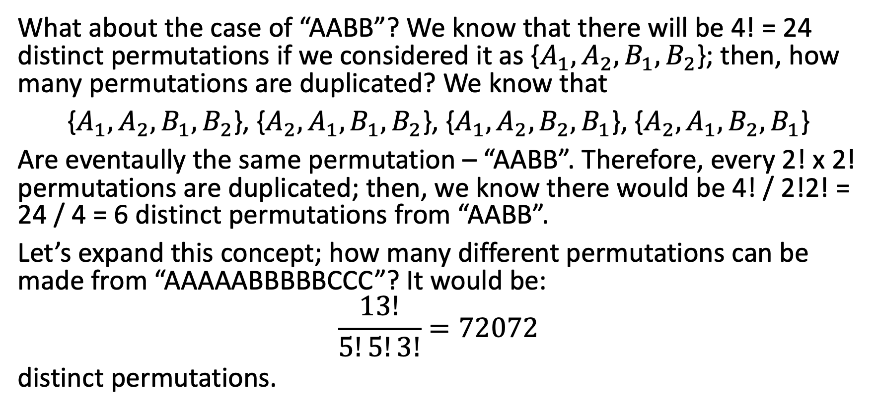
Permutation with Repetition
What about the case of “AABB”? We know that there will be 4! = 24 distinct permutations if we considered it as {$A_{1},A_{2},B_{1},B_{2}$}; then, how many permutations are duplicated? We know that
{$A_{1},A_{2},B_{1},B_{2}$}, {$A_{2},A_{1},B_{1},B_{2}$}, {$A_{1},A_{2},B_{2},B_{1}$}, {$A_{2},A_{1},B_{2},B_{1}$}
Are eventaully the same permutation – “AABB”. Therefore, every 2! x 2! permutations are duplicated; then, we know there would be 4! / 2!2! = 24 / 4 = 6 distinct permutations from “AABB”.
Let’s expand this concept; how many different permutations can be made from “AAAAABBBBBCCC”? It would be:
$$\frac{13!}{5!5!3!}=72072$$
distinct permutations.

Slide 63
Example 4-4-5
How many distinct permutations can be made from the characters in the word “MISSISSIPPI”?

Slide 64

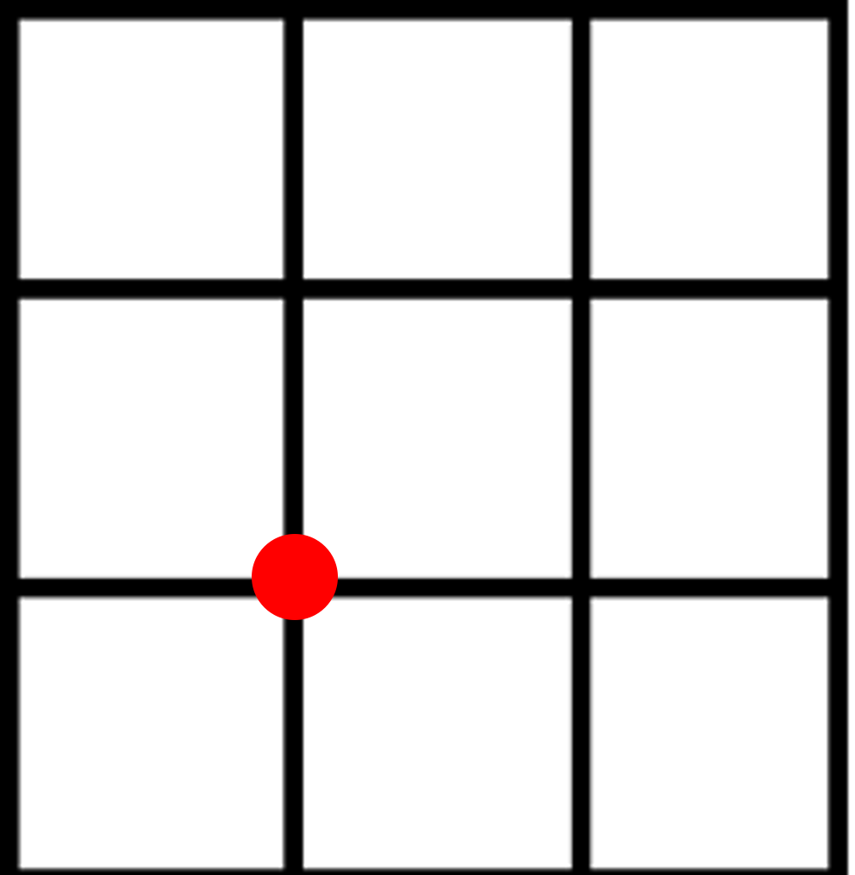
Example 4-4-6
How many distinct paths do we have, if we aim to go from the bottom left corner to the top right corner?
What if we cannot go through the red points?

Slide 65
Combinations with Repetition
Let’s consider this question – supposed a candy store has blue, red and green candies. Mike wants to buy 3 candies; how many distinct combinations can he have? It would be:
3 blues and 0 red and 0 green
2 blues and 1 red and 0 green
2 blues and 0 red and 1 green
1 blue and 2 red and 0 green
1 blue and 1 red and 1 green
1 blue and 0 red and 2 green
0 blue and 3 red and 0 green
0 blue and 2 red and 1 green
0 blue and 1 red and 2 green
0 blue and 0 red and 3 green
Totally 10 different possible combinations.

Slide 66
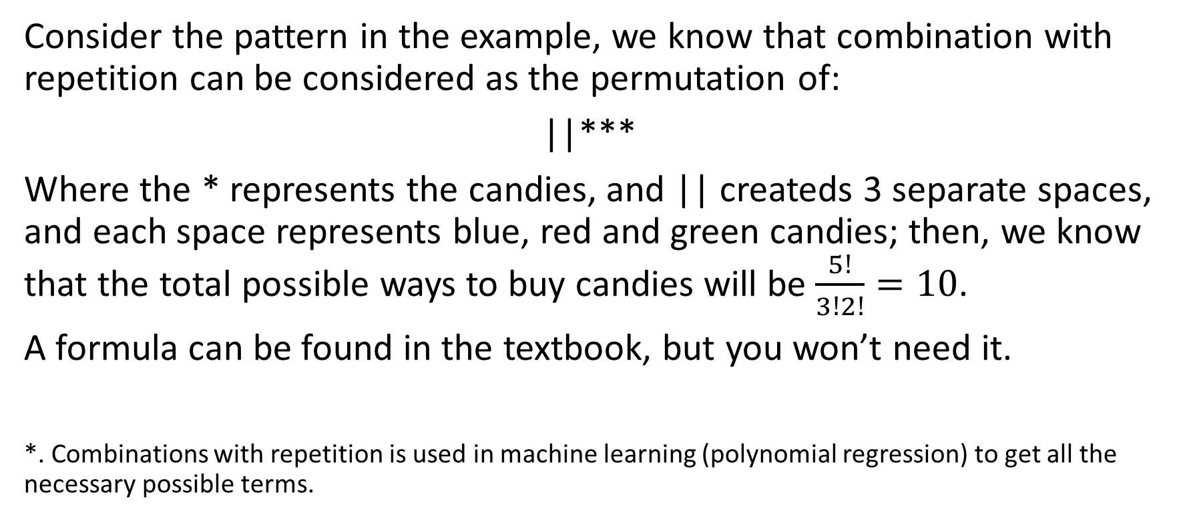
Combinations with Repetition
Consider the pattern in the example, we know that combination with repetition can be considered as the permutation of:
||***
Where the * represents the candies, and || createds 3 separate spaces, and each space represents blue, red and green candies; then, we know that the total possible ways to buy candies will be $\frac{5!}{3!2!}=10$.
A formula can be found in the textbook, but you won’t need it.
*. Combinations with repetition is used in machine learning (polynomial regression) to get all the necessary possible terms.

Slide 67
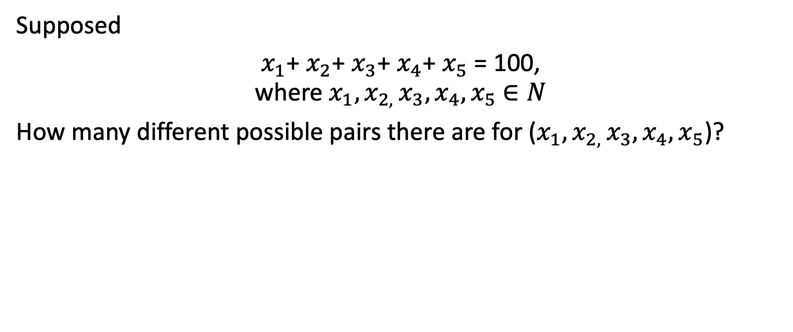
Example 4-4-7
Supposed
$x_{1}$+ $x_{2}$+ $x_{3}$+ $x_{4}$+ $x_{5}$ = 100, where $x_{1}, x_{2, }x_{3}, x_{4}, x_{5}$ $∈N$
How many different possible pairs there are for ($x_{1}, x_{2, }x_{3}, x_{4}, x_{5}$)?

Slide 68
Coding Lesson
Write a function called “permutation()” that takes in an array of anything as input, and return all the possible permutations of elements in the array.

Slide 69

4-5 Binomial Theorem

Slide 70
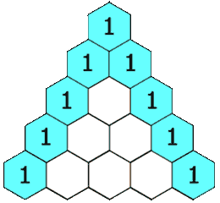
Pascal’s Triangle
Before we learn the concept of binomial theorem, we need to learn about Pascal’s triangle first.
Pascal’s Triangle is names after the seventeenth-century French mathematician Blasie Pascal. Pascal’s triangle builds its new row by adding every 2 elements of the previous rows.

Slide 71
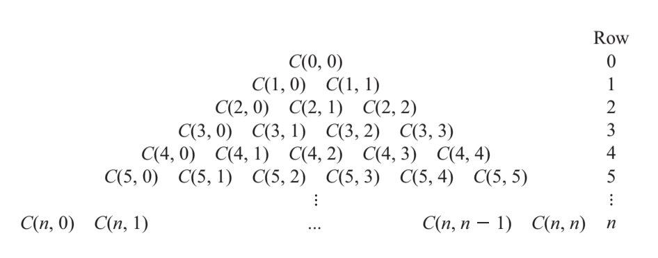
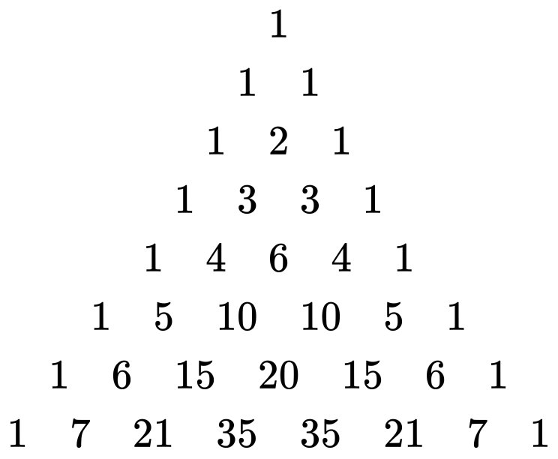
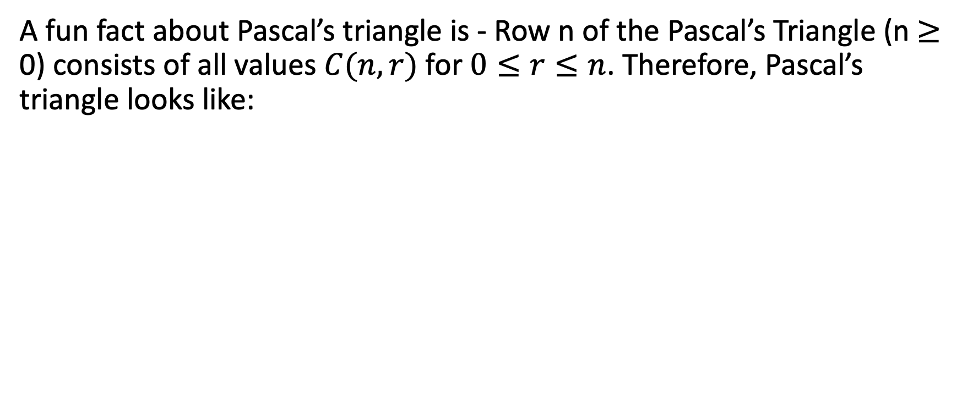
Pascal’s Triangle
A fun fact about Pascal’s triangle is - Row n of the Pascal’s Triangle (n $≥$ 0) consists of all values $C(n, r)$ for $0≤r≤n$. Therefore, Pascal’s triangle looks like:

Slide 72
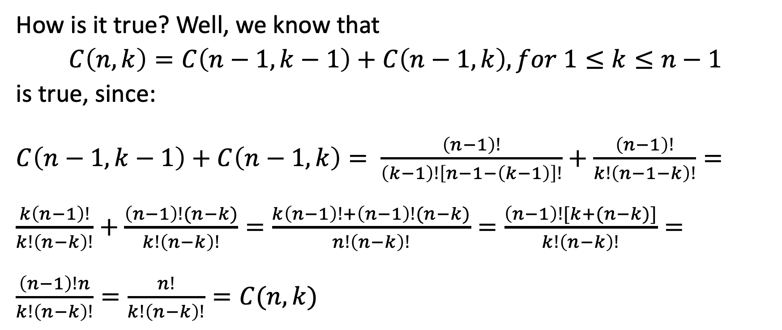
Pascal’s Triangle
How is it true? Well, we know that
$C\left(n, k\right)=C\left(n−1, k−1\right)+C\left(n−1, k\right), for 1≤k≤n−1$
is true, since:
$C\left(n−1, k−1\right)+C\left(n−1, k\right)= \frac{\left(n−1\right)!}{\left(k−1\right)!\left[n−1−\left(k−1\right)\right]!}+\frac{\left(n−1\right)!}{k!\left(n−1−k\right)!}=\frac{k\left(n−1\right)!}{k!\left(n−k\right)!}+\frac{\left(n−1\right)!(n−k)}{k!\left(n−k\right)!}=\frac{k\left(n−1\right)!+\left(n−1\right)!(n−k)}{n!\left(n−k\right)!}=\frac{\left(n−1\right)![k+(n−k)]}{k!\left(n−k\right)!}=\frac{\left(n−1\right)!n}{k!\left(n−k\right)!}=\frac{n!}{k!\left(n−k\right)!}=C(n, k)$

Slide 73
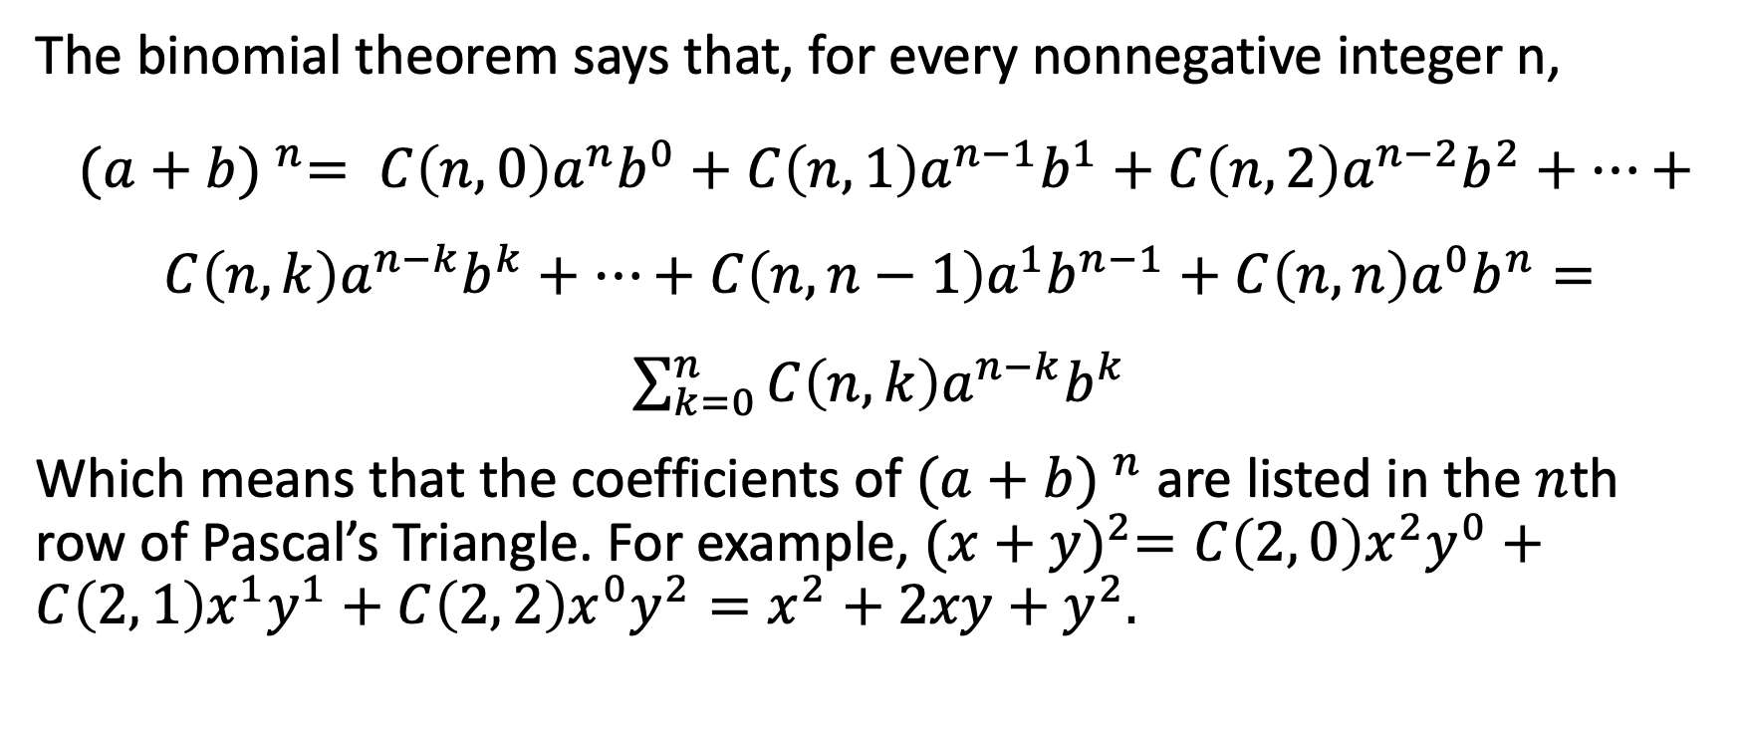
Binomial Theorem
The binomial theorem says that, for every nonnegative integer n,
${(a+b) }^{n}= C\left(n, 0\right)a^{n}b^{0}+C\left(n, 1\right)a^{n−1}b^{1}+C\left(n, 2\right)a^{n−2}b^{2}+…+C\left(n, k\right)a^{n−k}b^{k}+…+C\left(n, n−1\right)a^{1}b^{n−1}+C\left(n, n\right)a^{0}b^{n}=\sum_{k=0}^{n}{C\left(n, k\right)a^{n−k}b^{k}}$
Which means that the coefficients of ${(a+b) }^{n}$ are listed in the $n$th row of Pascal’s Triangle. For example, ${(x+y)}^{2}={C\left(2, 0\right)x}^{2}y^{0}+{C\left(2, 1\right)x}^{1}y^{1}+{C\left(2, 2\right)x}^{0}y^{2}=x^{2}+2xy+y^{2}.$

Slide 74
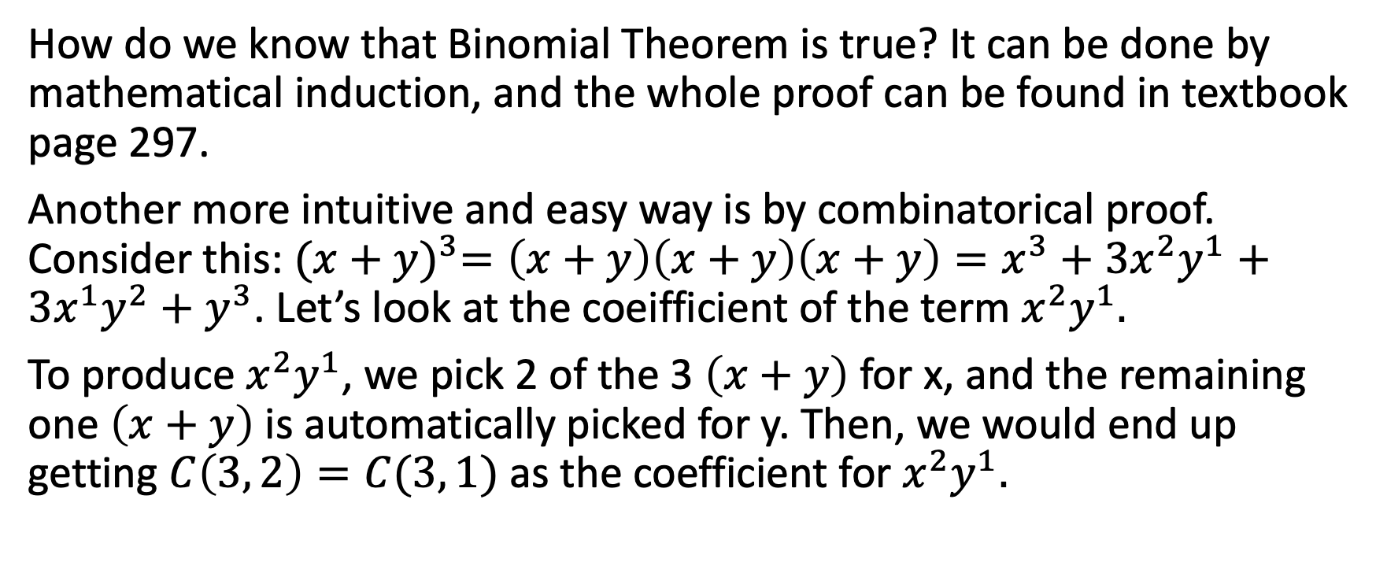
Binomial Theorem
How do we know that Binomial Theorem is true? It can be done by mathematical induction, and the whole proof can be found in textbook page 297.
Another more intuitive and easy way is by combinatorical proof. Consider this: ${(x+y)}^{3}=\left(x+y\right)\left(x+y\right)\left(x+y\right)=x^{3}+3x^{2}y^{1}+3x^{1}y^{2}+y^{3}$. Let’s look at the coeifficient of the term $x^{2}y^{1}.$
To produce $x^{2}y^{1}$, we pick 2 of the 3 $\left(x+y\right)$ for x, and the remaining one $\left(x+y\right)$ is automatically picked for y. Then, we would end up getting $C\left(3, 2\right)=C(3, 1)$ as the coefficient for $x^{2}y^{1}.$

Slide 75
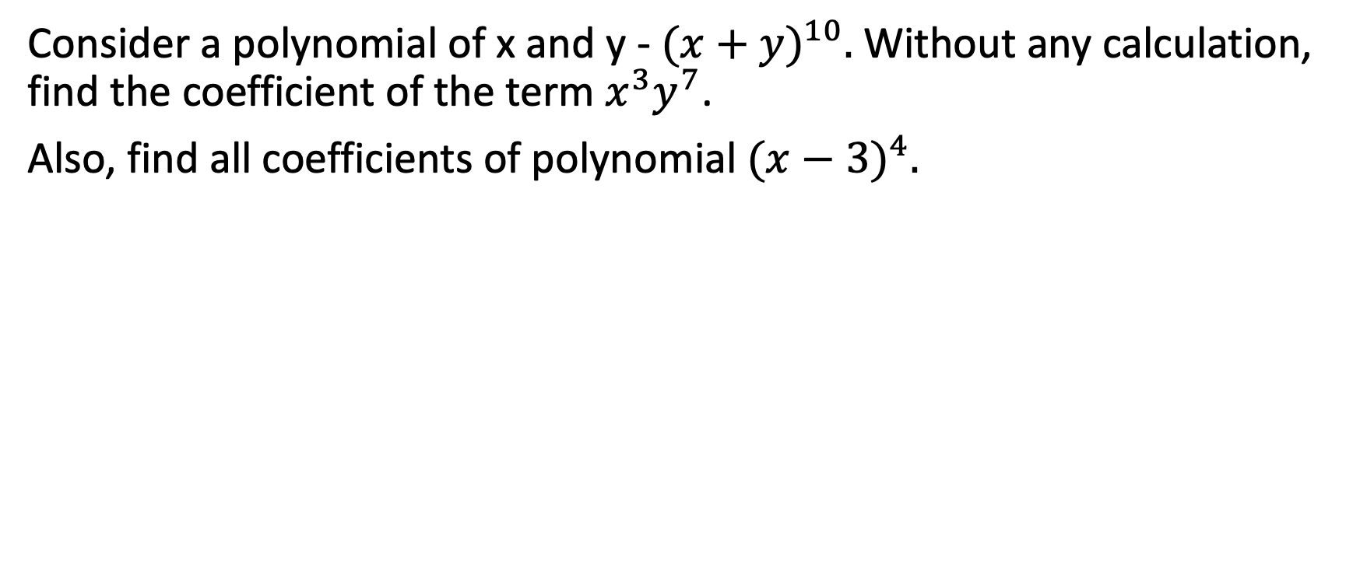
Example 4-5-1
Consider a polynomial of x and y - ${(x+y)}^{10}.$ Without any calculation, find the coefficient of the term $x^{3}y^{7}$.
Also, find all coefficients of polynomial ${(x−3)}^{4}.$

Slide 76

Number of Subsets
In previous chapters, we learned that for a set of $n$ elements, the total number of distinct subset will be $2^{n}$ without giving a proper explanation.
How do we count the total number of subsets? We know that for a set of 4 elements, the total number of subsets will be $C(4, 0)$different subsets that contains 0 element, and $C\left(4, 1\right)$ different subsets that contain 1 element, and $C\left(4, 2\right)$ different subsets that contain 2 elements, and $C\left(4, 3\right)$ different subsets that contain 3 elements, and $C(4, 4)$ different subsets that contain 4 elements.
Therefore, the total number of subsets will be $C\left(4, 0\right)+C\left(4, 1\right)+C\left(4, 2\right)+C\left(4, 3\right)+C\left(4, 4\right)$.

Slide 77

Number of Subsets
Now, how do we compute the value of $C\left(4, 0\right)+C\left(4, 1\right)+C\left(4, 2\right)+C\left(4, 3\right)+C\left(4, 4\right)$, other than simple brute force calculation? Or in general, is there a faster way to compute $C\left(n, 0\right)+C\left(n, 1\right)+…+C(n, n)$?
Since ${(a+b) }^{n}= C\left(n, 0\right)a^{n}b^{0}+C\left(n, 1\right)a^{n−1}b^{1}+C\left(n, 2\right)a^{n−2}b^{2}+…+C\left(n, k\right)a^{n−k}b^{k}+…+C\left(n, n−1\right)a^{1}b^{n−1}+C\left(n, n\right)a^{0}b^{n}$, we can simply set a and b to be 1; then, we would get that
$2^{n}=C\left(n, 0\right)+C\left(n, 1\right)+…+C(n, n)$
This is the proof of number of subsets.
*. This concept is also used in algorithm and data structure, as we analyze the complexity of algorithms.

Slide 78

Coding Lesson
Write a function called “Pascal()”, which takes in an input of positive integer, and returns an array of integers in the $n$th row of the Pascal’s Triangle.

Slide 79

4-6 Probability

Slide 80
Random Experiment and Sample Space
A Random Experiment is an experiment, trial, or observation that can be repeated numerous times under the same conditions. The outcome of an individual random experiment must be independent and identically distributed. It must in no way be affected by any previous outcome and cannot be predicted with certainty.
The sample space S of a random experiment is defined as the set of all possible outcomes of that random experiment.
For example, tossing a normal and standard die is a random experiment. The sample space S is {1, 2, 3, 4, 5, 6}.

Slide 81

Event and Probability
An event is a subset of sample space. The probability of an event happening is the number of elements in that event divided by the number of elements in sample space.
For example, what the probability of getting 2 or 5, when tossing a standard normal die? The event is {2, 5}, and the sample space is {1, 2, 3, 4, 5, 6}; then, we know that the probability of event happening is:
$P\left(A\right)= \frac{2}{6}$

Slide 82
Example 4-6-1
When tossing 2 standard normal dice, under the condition that the sum of 2 dice is 6, what’s the probability of one of the die value is 2?

Slide 83
Example 4-6-2
When picking one random card from a deck of 52 poker cards, what’s the probability of:
1. Getting a heart
2. Getting a joker
3. Getting a heart King

Slide 84
Example 4-6-3
Supposed we have 2 decks of poker cards, with 52 cards in each deck. 2 decks are combined into one deck, shuffled, and redistributed into 2 halves. Supposed that we draw one card from each halve, what’s the probability of getting the same card?
(Hint: This is the same as picking 2 random cards from a deck of 104 cards, and finding the probability of getting 2 identical cards.)

Slide 85
Example 4-6-4
A random experiment is to toss a die twice; then:
What’s the sample space?
What’s the probability of getting 2 consecutive 6?
What’s the probability of getting at least one 3?
What’s the probability of getting at least one multiple of 2?

Slide 86

Conditional Probability
Conditionaly Probability means that , under the condition of event B is happening, what is the probability of event A happening?
The formula is:
$$P\left(A \right| B)=\frac{P(A \bigcap{B})}{P(B)}$$
Consider this example: We know that 12% of patients get side effects after taking medicine A, and 30% of patients get side effects after taking medicine B. 9% of patients get side effect on both medicine A and B. Then, given a patient that already has side effect after taking medicine B, what’s the probability of this patient getting side effect after taking medicine A?

Slide 87

Conditional Probability
We know that 3% of the patients would get side effects after taking medicine A but wouldn’t after taking medicine B, and 21% of the patents would get side effects after taking medicine B but wouldn’t after taking A.
Therefore, a patient that took medicine B and have side effects falls in the 30% set. Under this assumption, the probability of this patient getting side effects after taking medicine A would be:
$P\left(A \right| B)=\frac{P(A\bigcap{B})}{P(B)}=\frac{9\%}{30\%}=30\%$

Slide 88

Conditional Probability
An easier way to understand this is by using numbers. Supposed the total number of patients is 100. 12 people would get side effects of A, 30 people would get side effects of B, 9 people get both. Then, given among those 30 people, what’s the probability of seeing a person getting side effects on both medicine?
It’s clearly 9 / 30 = 30%.

Slide 89
Example 4-6-5
Given that 60% of students at BYU are male, 40% of them are female. All the males wear pants, and 50% of female wear pants, 50% of female wear skirts. Supposed that you see someone standing far away from you is wearing pants, what’s the probability of this person being a female?

Slide 90

Bayes Theorem
The Bayes theorem says that:
$P\left(A \right| B)=\frac{P(A \bigcap{B})}{P(B)}=\frac{P\left(B \right| A)P(A)}{P(B)}$
To prove this, we do:
$P\left(A \right| B)=$ $\frac{P(A \bigcap{B})}{P(B)}, P\left(B \right| A)=\frac{P(B \bigcap{A})}{P(A)}$, then, $P\left(B \bigcap{ A}\right)=P\left(A\right)P(B|A)$, then, we know $P\left(A \right| B)=\frac{P\left(B \right| A)P(A)}{P(B)}$

Slide 91
Bayes Theorem
Suppose, a particular test for whether someone has been using cannabis is 90% sensitive, meaning that 90% of cannabis user will get tested “positive”.
The test is also 80% specific, meaning that 80% of non-cannabis user will get tested “negative”.
Assumed that 5% of the population is cannabis user, then what is the probability that a random person who tests positive is really a cannabis user?
This is actually asking the conditional probability P (Cannabis-User | Tested Positive), meaning what the probability is of someone being a true cannabis user if this person is tested positive.
*. The anser is not 90%.

Slide 92

Bayes Theorem
According to the Bayes Theorem, we do:
$$P\left(Cannabis User \right| Tested Positive)= \frac{P\left(Tested Positive \right| Cannabis User) P(Cannabis User)}{P(Tested Positive)}$$
Wait… what’s the probability of getting tested positive (for a random person)? It would be 5% x 90% + 20% x 95% = 23.5%. Why? Well, this has something to do with “the law of total probability”, which is not the focus of discrete math. A simpler way of getting this value will be:

Slide 93

Bayes Theorem
Imagine 100 random people come to get tested. We know 5 of them are real cannabis users, and 95 of them are not. Then, we know that:
1. 5 real cannabis user get tested, the test is 90% correct, so 4.5 of them will get tested positive.
2. 95 non-cannabis users get tested, the test is 80% correct, so 19 of them will get tested postive.
Overall, we see that 4.5 + 19 = 23.5 people, out of 100, get testes positive. Therefore, the $P\left(Positive\right)=23.5\%$
With this result, we can continue.

Slide 94

Bayes Theorem
$$P\left(Cannabis User \right| Tested Positive)= \frac{P\left(Tested Positive \right| Cannabis User) P(Cannabis User)}{P(Tested Positive)}=\frac{90\% ∗5\% }{23.5\%}=\frac{0.045}{0.235}≈0.19=19\%.$$
Here we can see that, if someone gets tested positive, there’s only 19% chance for him to be a true cannabis user; this is the power of Bayes Theroem.

